Slide 1
Threat-driven Software Development Planning: Using CAPEC & CWE to Improve SDLC September 23, 2011

Slide 2
Agenda
Introductions
Common Attack Pattern Enumeration and Classification (CAPEC)
Common Weakness Enumeration (CWE)
Penetration Testing: Real-world Examples
Open Q&A

Slide 3
Introductions
What I am
Application Penetration Tester
Vulnerability Assessor
Security Consultant
What I am not
Authoritative source for CVE, CWE, or CAPEC entries
What we’re here to discuss
CWE & CAPEC use scenarios
Penetration test case study

Slide 4
CAPEC
Common Attack Pattern Enumeration and Classification
Draft data dictionary of attack patterns
Intended to standardize threat description taxonomy
Useful in security planning related to:
Security requirements development
Software design specification
Functional (QA/Security) testing
Penetration test case identification

Slide 5
Threat Modeling
Critical Component to Software Design & Security Testing
Authorization Abuse
Improper Access Control
Privilege Escalation
Excess Privilege
ACL Mis-configuration

Slide 6
CWE
Common Weakness Enumeration
Data dictionary of system flaws (vendor agnostic)
Standardization of vulnerability description taxonomy
Useful in security planning related to:
Security test report results attribution
Centralization of development support resources
Encyclopedia of development errors

Slide 7
CWE Example
CVE vs CWE Usefulness
Custom development projects
Newly identified vulnerabilities
Single location for additional developer resources
Improper Input Validation
Previously undisclosed input validation flaws come up during every pentest
XSS, Application-side SQL injection, Command injection, DoS
What happens when argv[1] has a
length greater than 7?
#include <string.h> // for strcpy
int main(int argc, char *argv[])
{
char buff[8];
strcpy( buff, argv[1] );
return 1;
}

Slide 8
Relationships
CVE
CWE
CAPEC
Common Vulnerability Enumeration
Vendor specific
Identified, validated vulnerabilities
Specifics
Common Weakness Enumeration
Vendor agnostic
Categories of exploitable errors based on historical vulnerabilities
Common Attack Pattern Enumeration and Classification
Implementation agnostic
Threat modeling
Vulnerability and exploit identification approach

Slide 9
Putting SDLC Tools into Action
System Development Life Cycle Support
Requirements
Design
Development
Testing
Maintenance
Application Security Requirements Analysis
Application Security Design Review
Application Code Review
Application Penetration Testing/ Vulnerability Assessment
Periodic Reviews/ Application Penetration Testing
Applications
Infrastructure Security Requirements Analysis
Infrastructure Security Design Review
Infrastructure Configuration Review
Penetration Testing/ Vulnerability Assessment
Periodic Configuration Reviews/ Infrastructure Penetration Testing
Infrastructure
Provide guidance and interpretation of security policies & requirements; support development of security-related functional and technical requirements; identify threat models appropriate to the business objectives
Support system security design, validate design decisions against threat data, and assist in the selection of controls that suit the architecture of the system
Conduct reviews of modules/Components to validate design specifications
Support the development of appropriate test cases, scenarios, and procedures to tailor to the specific operating environment; intent is to test “functional” security requirements
Support analysis of continuous monitoring results and recommend technical enhancements to continue to improve security posture
Security

Slide 10
Requirements Analysis
Key Considerations
Security’s Role
Understand the threat environment and potential pitfalls (CAPEC/Top 25 CWE/OWASP)
Criticality Categorization (C/I/A)
Security Requirements: biggest challenge comes from interpreting the requirements within the context of the architecture
Review your agency’s policies, standards, and Enterprise Architecture to ensure proper alignment
Conduct threat modeling prior to requirements phase (understand what threat scenarios you’re concerned about)
Providing enough interpretation and expertise in defining the proper security requirements (understanding the malicious mindset to prevent the mistakes)
Injecting the proper security requirements within the context of the architecture

Slide 11
Design Considerations
Area | Guidelines
Input Validation | Don’t trust input; validate input: length, range, format and type; constrain, reject, sanitize input
Authentication | Use strong password policies; Don’t store credentials; Encrypt communication channels to secure authentication tokens; use HTTPs only with Forms cookies
Authorization | Use least privilege accounts; Consider granularity of access; Enforce separation of privileges
Configuration Management | Use least privileged service accounts; Don’t store credentials in plaintext; Use strong authentication and authorization on administrative interfaces; Don’t use the LSA; avoid storing sensitive information in the web space
Sensitive Data | Don’t store secrets in software; Enforce separation of privileges; Encrypt sensitive data over the wire; Secure the channel
Session Management | Partition site by anonymous, identified and authenticated; reduce the timout; avoid storing sensitive data in Session; Secure the channel
Parameter Manipulation | Don’t trust fields the client can manipulate (Query string, Form fields, Cookie values, HTTP headers)
Exception Management | Use structured exception handling (try-catch); Only catch and wrap exceptions if the operation adds value/information; Don't reveal sensitive system or app info; Don't log private data (passwords ... etc.)
Cryptography | Don’t roll your own; XOR is not encryption; RNGCryptoServiceProvider for random numbers; Avoid key management (use DPAPI); Cycle your keys
Auditing and Logging | identify malign or malicious behavior; know your baseline (what does good traffic look like); instrument to expose behavior that can be watched (the big mistake here is typically app instrumentation is completely missing)

Slide 12
Development
Identify Source Code to be Reviewed
Choose a threat path. Start with highest risk.
If critical processing modules identified, review those modules first.
Identify source code modules for components on the threat path
Identify source code for utility classes and functions used by modules on the threat path
Review code for known classes of problems
Arbitrary code injection: buffer overflows and format string attacks
Race conditions
Inadequate privilege checking
Canonicalization issues
Error handling
Information leakage
Script injection
Cryptographic implementation errors
Code Review Toolkit
Source Code Analyzers provide developers with the ability to conduct unit testing for security vulns
Examples: Fortify, AppScan/Prexis, Rietveld, etc

Slide 13
Testing
Key Considerations
Security’s Role
Choose a comprehensive approach to include all components:
Web App Pen. Testing
Infrastructure Pen. Testing
SOA Application Pen Testing
Testing should occur as early as possible to provide time for remediation
Make sure the rules are established for the testing (put a Rules of Engagement in place)
Simulation of threat vectors and attack scenarios identified during threat modeling
Identification of attacks that could compromise the system or data
Documentation of the vulnerabilities and risks
Providing recommendations to support remediation

Slide 14
Penetration Testing:
Real-World Examples

Slide 15
Overview: Application Penetration Test
System Information
Our Objectives
4-tier J2EE Internet-facing Web Application
Apache JBOSS
Windows Server 2008
MS SQL Server 2008
Contains highly sensitive information related to personally identifiablee information (PII)
Development timeframe was 6 months start to finish
Leveraged a COTS product as the core with custom development to meet the agency’s functional requirements
Provide security subject matter expertise to support all phases of the SDLC and integrate into the development project plan
Obtain an Authorization to Operate (ATO) for the new system as required under FISMA
Ensure risks are identified as early in the SDLC as possible to minimize the cost of potential vulnerabilities later in the SDLC
Conduct final Security Assessment using Application Penetration Testing techniques and infrastructure vulnerability assessment

Slide 16
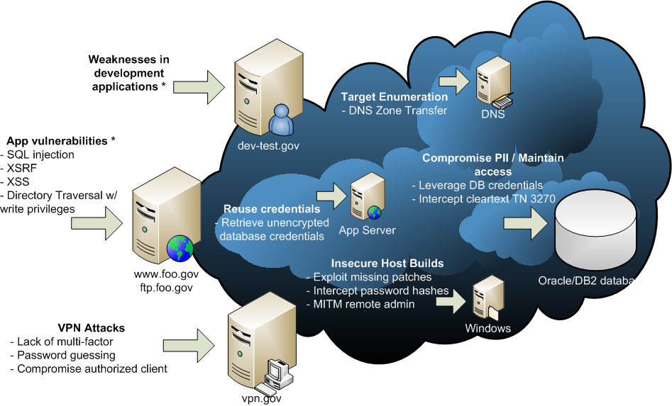
Threat Modeling: Client-specific

Slide 17
Anatomy of an attack
Open Source Intel
Public Accessibility
Privilege Escalation
Data-centric
Exploitation
Data Exfiltration
Identification of potential client-side targets
Spear phishing preparation
Review of social network profiles
Email address harvesting
Identification of publicly accessible services
Service fingerprinting
Public vulnerability research
Network profiling
Development environment exploitation
Application layer vulnerabilities
VPN password guessing
Malicious authorized users
Authorized client compromise
Exploitation of internal vulnerabilities
Network spidering
Expand access
Database exploitation
Credential Intercept
Man-in-the-middle attacks
Mainframe attacks
Credential Reuse
Data harvesting
Removal of data from the interior network
Transmit externally via SMTP, HTTPS

Slide 18
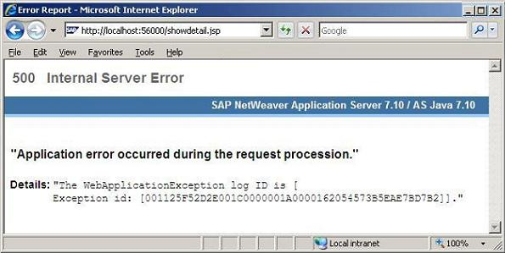
Input Validation: Proper handling of user input?
What if I inject "'" or 1=1;-- into the “Search” box…
Something isn’t right…looks like insufficient scrubbing of my input and definitely wasn’t expecting it
CWE | CAPEC
CWE-209: Information Exposure Through an Error Message | CAPEC 152: Injection

Slide 19
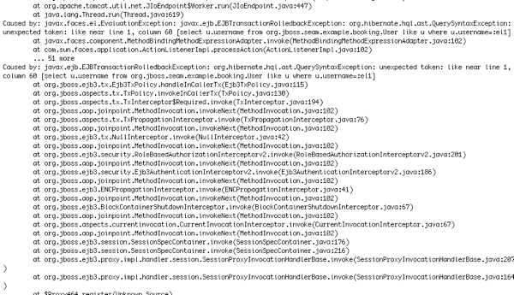
Error Handling: Too Much Information
Building on the last step…we’re getting SQL fragments. Sign of a SQL Injection…
CWE | CAPEC
CWE-209: Information Exposure Through an Error Message | CAPEC 66: SQL Injection

Slide 20
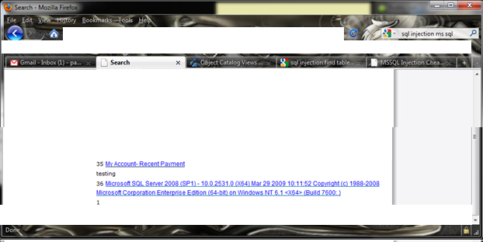
SQL Injection: Can I get to the data?
Let’s test how far I can get with this SQL Injection and test the limits…
Couple things here...the application logic from the search box kept interpreting spaces as separate search terms.
To pull this off we had to create a SQL query with no spaces in it…
How’d I accomplish that…I used SQL comment characters /**/
Here’s the injection string…
'UNION/**/ALL/**/SELECT/**/1,36,@@version,'1','1','1',1,'1';--
Look mom…no spaces!
In fairness, they used PreparedStatements which means…variables passed as arguments to prepared statements will automatically be escaped by the JDBC driver.
However, all queries should be parameterized and not passed directly to the query which is why this was possible:
PreparedStatement prepStmt = con.prepareStatement("SELECT * FROM user WHERE userId = '+strUserName+'");
Simple test against SQL Server to pull the server information.
CWE | CAPEC
CWE-89: Improper Neutralization of Special Elements used in an SQL Command | CAPEC-109: Object Relational Mapping Injection

Slide 21
Full Compromise: There goes my data…
The injection string…'UNION/**/ALL/**/SELECT/**/1, ssn, ssn,null,null, first_name,1,null/**/FROM/**/peoples_PII;--
Here’s Johnny!!! We used test data to simulate the SSN.
In the end, I want to make off with the information and all I had to do was dump it to the “Search” results page and I’m home free…
Went right through an HTTPS port without even being seen…every firewall has those ports open (although an application firewall may have caught this)
CWE | CAPEC
CWE-89: Improper Neutralization of Special Elements used in an SQL Command | CAPEC-109: Object Relational Mapping Injection

Slide 22
Access Control: How deep do I go?
Building on the last step I know a couple of things:
The “Search” box is available without authentication yet I still have access to SQL Server system tables…
Indication the access control model is broken
This function should not have read/write/update/delete access to any tables outside of the table it needs and even then should only be read access
Common mistake is to think hackers will never get that far back to even touch the database
CWE | CAPEC
CWE-732: Incorrect Permission Assignment for Critical Resource | CAPEC-122: Exploitation of Authorization

Slide 23
Local File Inclusion
CWE | CAPEC
CWE-98: Improper Control of Filename for Include | CAPEC-48: Passing Local Filenames to Functions that Expect a URL

Slide 24
Clear-text Passwords: But it’s only on my internal network…
Looks like we can traverse to the web.xml and pull out cleartext passwords…
CWE | CAPEC
CWE-311: Missing Encryption of Sensitive Information | CAPEC-118: Data Leakage Attacks

Slide 25
Lessons Learned
Difficult to predict, in advance, every possible permutation of a vulnerability
Exploitation scenarios are possible due to multiple vulnerabilities tied together
There was clear intent to implement security but somewhere in the middle…things got “lost in translation” between security and the development team
Where do we go from here…
Better education to help developers understand the potential threat scenarios and attack paths and have the “hacker mindset”
Application security continues to evolve with the technology but the general principles remain the same
We (security and IT) must continually work together and improve our processes and technologies to mitigate these risks (I promise security is not there to be a complete PITA…)

Slide 26
Contact
Ryan Stinson
Chief, KCG Cyber Security Center of Excellence
Ryan.stinson@knowledgecg.com
Knowledge Consulting Group (KCG)
11710 Plaza America Dr., Ste 520
Reston, VA 20190
Voice: 703.467.2000
http://www.KnowledgeCG.com

