Slide 1
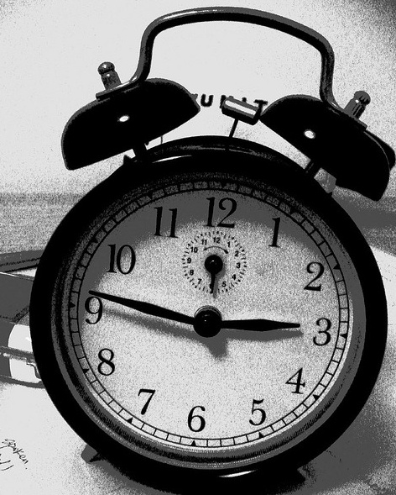
Top Ten Risks With Cloud That Will Keep You Awake at Night
Shankar B Chebrolu, PhD, CISSP,
Vinay Bansal,
Pankaj Telang
(OWASP Cloud Top Ten Project Co-Leads)
Cisco Systems Inc
shbabu@cisco.com
9193925363
Sep 22, 2011

Slide 2
Agenda
Cloud Models and Actors
OWASP Cloud Top 10 Security Risks
Q & A
Cloud – Industry Adoption Trend
Mitigation Strategies
OWASP Cloud Top 10 Project
Motivation and Approach
Notes:
updated

Slide 3

Cloud Top 10 Project: Motivation
Develop and maintain Top 10 security “Risks” with Cloud models similar to
“OWASP Top 10 Web Application Security Risks”
Serve as a quick list of top risks with cloud adoption
Provide guidelines on mitigating the risks

Slide 4
Cloud Top 10 Project: Approach
Most Damaging
Incidence Frequency
Easily Executable
ISC2
CSA
Industry
Experience
News/
Research Publications
IDC
Gartner
NIST
OWASP
Cloud Top 10

Slide 5
Cloud: Industry Adoption Trend
(Source Gartner)

Slide 6
Impact of Cloud Adoption on IT Effectiveness
Cloud
Cloud
Adoption
(Independent
Variable)
Connectivity
Modularity
IT QOS
Compatibility
IT
Effectiveness
(Dependent
Variable)
User Satisfaction
Strategic
Alignment
(Independent
Variable)
IT helpfulness to Users
Legend:
Primary Relationship
Secondary Relationship

Slide 7
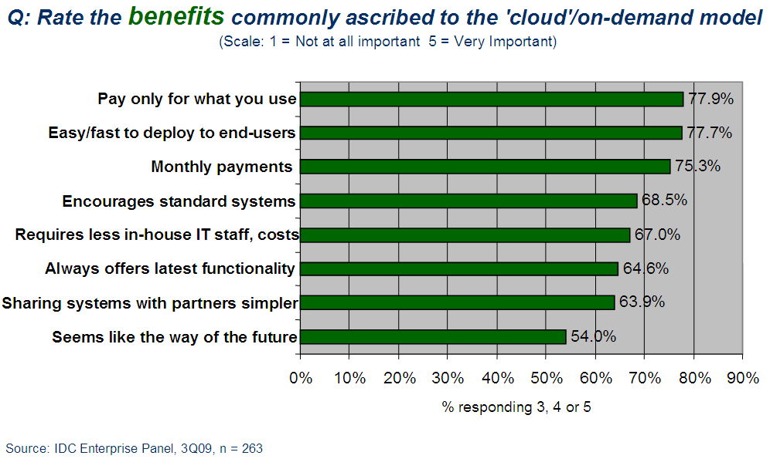
Market Research - Cloud Benefits

Slide 8
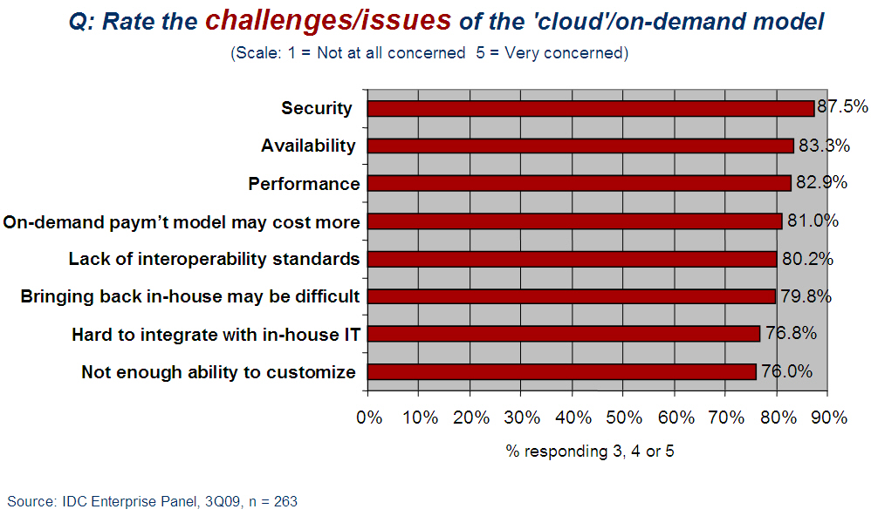
Market Research - Cloud Challenges

Slide 9
Cloud Models
Service Models
Deployment Models
Software as a
Service (SaaS)
Public
Private
Platform as a
Service (PaaS)
Hybrid
Infrastructure as a
Service (IaaS)
Community
Broad Network
Access
Rapid Elasticity
Measured Service
On-Demand Self-Service
Resource Pooling
(Adapted from CSA Guide, originally from NIST)

Slide 10
Cloud Actors
Cloud
Consumer
Cloud
Auditor
Cloud
Broker
Cloud Provider
Source: (NIST: http://collaborate.nist.gov/twiki-cloud-computing/pub/CloudComputing/StandardsRoadmap/NIST_SP_500-291_Jul5A.pdf)

Slide 11
Cloud Top 10 Security Risks
R1: Accountability & Data Risk
R2: User Identities
R3: Regulatory Compliance
R4: Business Continuity & Resiliency
R5: User Privacy & Secondary Usage of Data
R6: Service & Data Integration
R7: Multi-tenancy & Physical Security
R8: Incidence Analysis & Forensics
R9: Infrastructure Security
R10: Non-production Environment Exposure

Slide 12
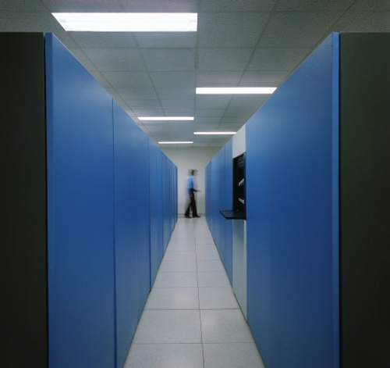
R1: Risk: Accountability & Data
In traditional data center, the owning organization is accountable for security at all layers
Application
Organization fully accountable for security at all layers
Web/App/DB server
Computing
Network
Storage
You can outsource hosted services but you cannot outsource accountability
In a cloud, who is accountable for security at these layers?
12

Slide 13
R1: Risk: Accountability & Data
Cloud Provider
Cloud Consumer
Application
*
Web/App/DB server
SaaS
Computing
Network
Storage
Application
Accountable
Accountable
Web/App/DB server
PaaS
Computing
Network
Storage
Application
Web/App/DB server
IaaS
Computing
Network
* Few exceptions
Storage

Slide 14
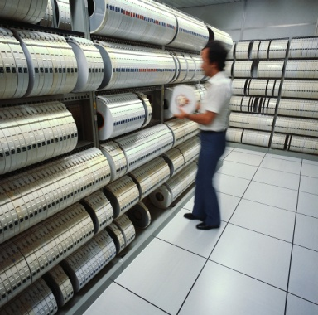
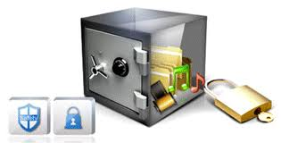

R1: Risk: Accountability & Data
How sensitive is the data?
Informal blogs
Twitter posts
Public news
Newsgroup messages
Health records
Criminal records
Credit history
Payroll
Who owns the data?
Data encrypted? Single vs. Unique keys
Data stored anywhere !!
14

Slide 15
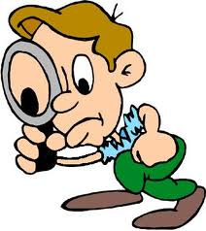

R1: Mitigations: Accountability & Data
Logical isolation of the data of multiple consumers
Provider fully destroys deleted data
Unique encryption keys
15

Slide 16
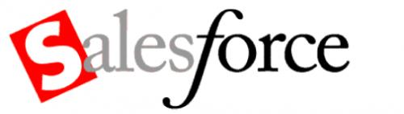

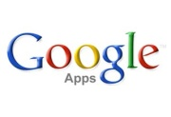

R2: Risk: User Identities
Security Risks
Managing Identities across multiple providers
Less control over user lifecycle (off-boarding)
User experience
Islands of User Identities
Enterprise

Slide 17


R2: Mitigations: User Identities
Mitigations
Federated Identity
OAuth for backend integrations
Tighter user provisioning controls
SAML
Identity Federation
Notes:
SAML – Security Assertion Markup Language

Slide 18
R3: Risk: Regulatory Compliance
Data that is perceived to be secure in one country may not be perceived
secure in another country/region
Lack of transparency in the underlying implementations makes it difficult for data owners to demonstrate compliance (SOX/HIPAA)
DC2
DC1
DC3
Lack of consistent standards and requirements for global regulatory compliance – data governance can no longer be viewed from a point-to-point data flow perspective but rather a multi-point to multi-point.
European Union (EU) has very strict privacy laws and hence data stored in US may not comply with those EU laws (US Patriot Act allows federal agencies limitless powers to access any corporate data etc)

Slide 19



R3: Mitigations: Regulatory Compliance
Define data protection requirements and SLAs
Apply risk management framework, case-by-case basis
Provider / Consumer agreement to a pre-defined RACI model
19

Slide 20


R4: Risk: Business Continuity & Resiliency
Lack of know-how and capabilities needed to ensure continuity & resiliency
Cloud provider may be acquired by a consumer’s competitor
Monetary losses due to an outage
20
Notes:
Business Continuity is …
activity an organization performs to ensure that critical business functions are available to the customers
Resiliency is …
property of a system to adapt itself to the consequences of a catastrophic failure caused by natural or man-made events
Cloud provider may not possess know-how and capabilities needed to ensure business continuity and resiliency
What happens when an outage occurs that last for multiple hours / days?
Implications when a cloud provider is acquired by a customer’s competitor

Slide 21

R4: Mitigations: Business Continuity & Resiliency
Contract defines Recovery Time Objectives, and monetary penalty for downtime
Cloud provider’s Business Continuity program certified to standard such as BS 25999
21
Notes:
Ensure customer Recovery Time Objectives (RTOs) are fully understood and defined in contractual relationships
Verify whether the cloud provider's Business Continuity Program is certified and/or mapped to internationally recognized standards such as BS 25999

Slide 22



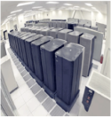
R5: Risk: User Privacy & Secondary Usage of Data
Users vs. Providers (Priorities)
Privacy of my data
  - Address, Email,.. (Personally Identifiable Information)
  - Health, personal financial info
  Personal Details (email, IMs, etc)
Keep Revenue Up/ Cost Down
  Push out the liabilities to user via Privacy and Acceptable Use Policy
  Build Additional Services on users behavior (targeted advertisements ) e.g. Google Email, banner adv.
  Do minimal to achieve compliance
  Keep their social applications more open (increased adoption)
End Users
Providers

Slide 23
R5: Risk: User Privacy & Secondary Usage of Data
User personal data mined or used (sold) without consent
  - Targeted Advertisements, third parties
User Privacy data transferred across jurisdictional borders
No opt out features for user (user can not delete data)
Lack of individual control on ensuring appropriate usage, sharing and protection of their personal information.
Notes:
Photo Bob Blakley/Burton

Slide 24
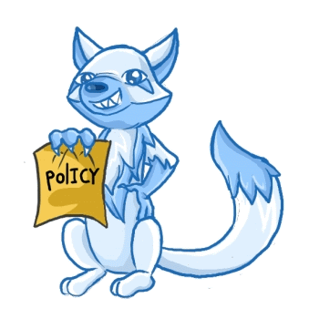
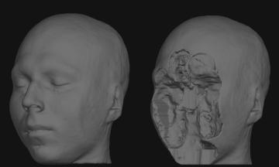

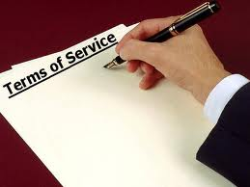
R5: Mitigations: User Privacy & Secondary Usage of Data
Policy Enactment
  Privacy and Acceptable Usage
  Consent (Opt In / Opt Out)
  Policy on Secondary Usage
De-identification of personal Information
Encrypted storage
Terms of Service with providers
  - Responsibility on compliance
  - Geographical affinity

Slide 25
R6: Risk: Service & Data Integration
Branch Office
Private Cloud / Internal Data Center
Key:
End Users
Cloud Broker
Internal Databases
Cloud Broker
Data traverses through the internet between end users and cloud data centers.
How secure the integrations are ?
Public Cloud
Cloud Provider 1
Cloud Provider 2
Proxy
Proxy
Cloud Broker
Service / App 1
Service / App 2
Service / App 5
Service / App 6

Slide 26
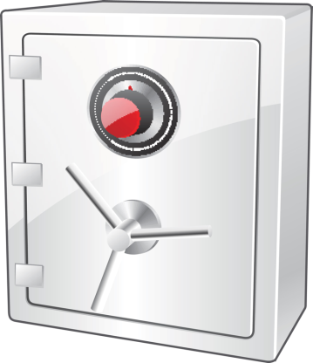
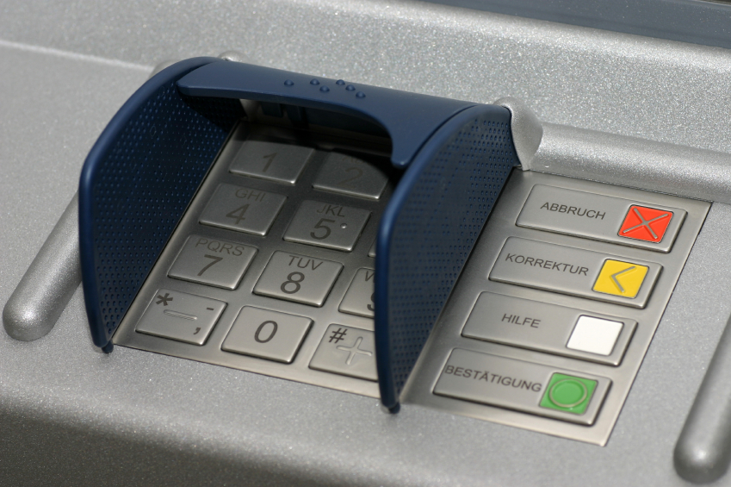
R6: Mitigations: Service & Data Integration
Data in Transit
Data at Rest
Encryption (keys, protocols etc)
26

Slide 27

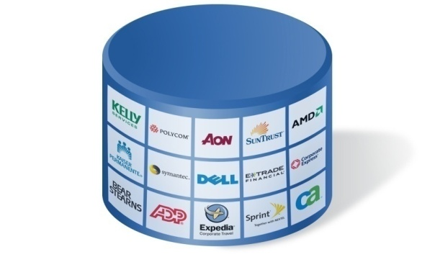



R7: Risks: Multi-tenancy and Physical Security
Web Tier
App/BizTier
Database Tier
Security Risks
Inadequate Logical Separations
Co-mingled Tenant Data
Malicious or Ignorant Tenants
Shared Service- single point of failures
Uncoordinated Change Controls and Misconfigs
Performance Risks
Cloud Consumers (Tenants)
Backups
Admin
Reach back to Enterprise
Notes:
http://www.owasp.org/index.php/Cloud-10_Multi_Tenancy_and_Physical_Security
Tenants -> Cloud Consumer
Single person to Orgs
Reachback
Points fly by

Slide 28


R7: Attacks and Incidences
MIT demonstrating cross-tenant attacks (Amazon EC2)*
  Side channel Attacks
  Scanning other tenants
  DoS
Wordpress Outage June 2010**
  100s of tenants (CNN,..) down in multi-tenant environment.
    Uncoordinated Change in database
* http://chenxiwang.wordpress.com/2009/11/02/mit’s-attack-on-amazon-ec2-an-academic-exercise/
** http://smoothspan.wordpress.com/2010/06/11/wordpress-and-the-dark-side-of-multitenancy/
Notes:
http://chenxiwang.wordpress.com/2009/11/02/mit’s-attack-on-amazon-ec2-an-academic-exercise/

Slide 29
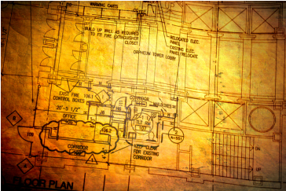
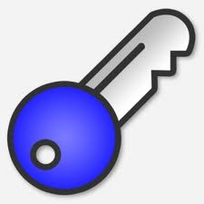
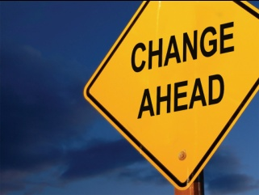


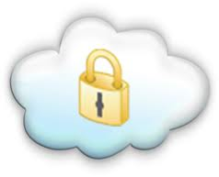
R7: Mitigations: Multi-tenancy and Physical Security
Architecting for
Multi-Tenancy
Data Encryption (per tenant key management)
Controlled and coordinated Change Management
Transparency/Audit-ability of Administrative Access
Regular Third Party Assessments
Virtual Private Cloud (VPC)

Slide 30
R8: Risk: Incidence Analysis & Forensic Support
Complex integration and dynamics in cloud computing present significant challenges to timely diagnosis and resolution of incidents such as:
  Malware detection and
  Immediate intrusion response to mitigate the impact
Branch Office
Private Cloud / Internal Data Center
Key:
End Users
Cloud Broker
Internal
Databases
Cloud Broker
Implications to Traditional Forensics ?
(seizing equipment and analysis on media/data recovered)
International differences in relevant regulations …
Public Cloud
Cloud Provider 1
Cloud Provider 2
Proxy
Proxy
Cloud Broker
Service / App 1
Service / App 2
Service / App 5
Service / App 6

Slide 31
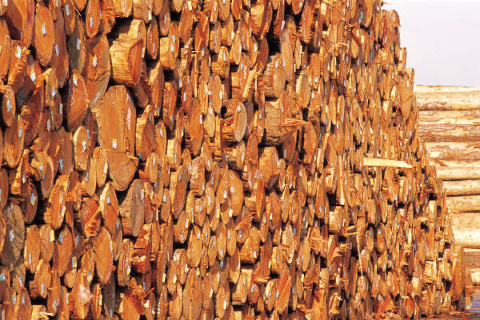


R8: Mitigations: Incidence Analysis & Forensic Support
Comprehensive logging
Without compromising Performance
Dedicated Forensic VM Images
31

Slide 32
R9: Risk: Infrastructure Security
Malicious parties are actively scanning the internet for …
Vulnerable Applications or Services
Key:
Active Unused Ports
Data
Default Passwords
Default Configurations

Slide 33

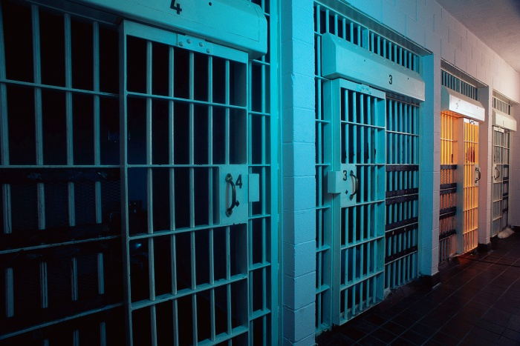
R9: Mitigations: Infrastructure Security
Third party audits and app vulnerability assessments
Segregation of duties and role based administrative privs
Tiered architecture with appropriate security controls between them
Hardening – Networks, OS, Apps

Slide 34


R10: Risk: Exposure of Non-Prod Environment
Non-Production Environments are …
used for design, development, and test activities internally within an organization
Prod
Non-Prod
Security flaws
Typical non-prod environment use generic authentication credentials
Data copied to non-prod from its production equivalent
Non-Prod
High risk of an unauthorized user getting access to the non production environment
34
Notes:
High risk of an unauthorized user getting access to the non-
production environment in publicly accessible cloud
Environment may be altered such that it becomes unusable
Unauthorized access is easier since typical non-production
environment use generic authentication credentials
Passwords may not conform to the standard password policy
Non-production environment may contain data copied from its
production equivalent
An unauthorized user can steal the sensitive production data such
as credit card and social security numbers.

Slide 35

R10: Mitigations: Exposure of Non-Prod Environment
Prod
Non-Prod
Use multi layers of authentication
Non-prod data is not identical to production
Don’t use cloud for developing a highly sensitive app in the cloud
35

Slide 36

Summary: Manage your Cloud Risks to sleep like a Baby
Photo - http://fineartamerica.com/featured/peaceful-sleep-ron-white.html
Notes:
Photo - http://fineartamerica.com/featured/peaceful-sleep-ron-white.html

