Slide 1
Gray, the New Black
Gray-Box Vulnerability Testing
Brian Chess, Ph.D.
Distinguished Technologist, HP
Founder and Chief Scientist, HP Fortify

Slide 2
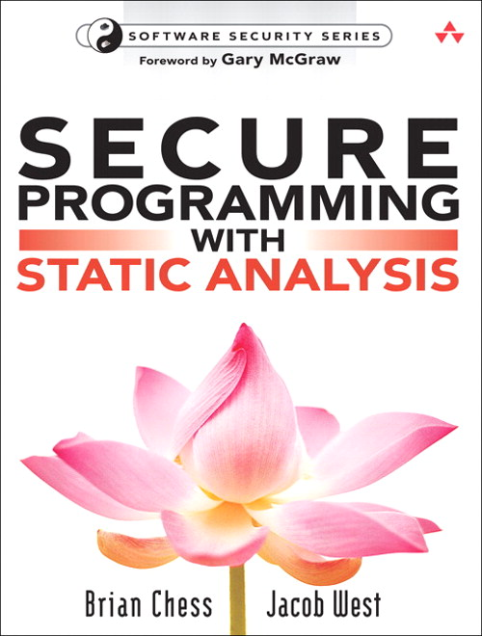
Brian Chess
Founder/Chief Scientist Fortify Software
Ph.D. from University of California 2002
Started Fortify Software 2003
Fortify acquired by HP 2010
Loves:
“Success is foreseeing failure”
Hates:
“The only way to stop the bad guys is to hunt them down and sue them until they stop.”

Slide 3
Todo
Why automated security testing
Popular testing techniques
Combining analysis approaches
Empirical results

Slide 4
Automated Security Testing is Critical Vulnerability-finding robots vs. hackers and better education
The supply of legacy code is never-ending
Don’t invest in security until you’ve created value
Secure today, hacked tomorrow
A constant and consistent need for re-testing
Security can’t be tested like a feature
Explore all corners of the application for all vulnerabilities
We need thorough and consistent vulnerability detection over enormous amounts of code
Notes:
1.1 Legacy code: We will always be playing catch-up because people build something of value before they try to protect it. Doing otherwise would be silly.
1.2 Even new code needs to be verified
1.3 Software security can't be tested as a feature--we need to explore the whole app. This makes typical feature-based testing methods not so useful.

Slide 5
Perfect Security Automation
Finds all the vulnerabilities (no false negatives)
Never wrong (no false positives)
Runs fast
Easy to use
Easy to know you’re using it correctly
Cheap

Slide 6
Black-Box Testing
System-level tests
No assumptions about implementation
Example: fuzzing
Good: concrete results
Bad: a losing game

Slide 7
The Software Security Game
Objective
Rules vs. Strategy
Playing Field

Slide 8
OBJECTIVE:
Protect everything
OBJECTIVE:
Exploit one vulnerability

Slide 9
Rules for the Defender
Don’t attack the attacker

Slide 10
Rules vs. Strategy
Rules
Don’t attack the attacker
Strategy
Emulate attacker’s techniques

Slide 11
Who wins?
Technology
Expertise

Slide 12
Who wins?
Technology
Expertise
Time

Slide 13
Who wins?
Technology
Expertise
Time

Slide 14
Changing the odds

Slide 15
The Defender’s Advantage
Time
Technology
Expertise
Inside Access

Slide 16
White-Box Testing
Examine implementation
Test components in isolation
Example: static analysis
Good: thorough
Bad: too thorough
Bad: no “show me” exploits

Slide 17
Gray-Box Testing
System-level tests (like black-box)
Examine implementation (like white-box)

Slide 18
Prior Art
2005: Concolic testing: Sen, University of Illinois
2008: SAGE: Godefroid, MSR
2008: Test Gen for Web Apps: Shay et al, U. Washington
2008: Accunetix: Accusensor

Slide 19
‘Hybrid’ Analysis
Application
Dynamic Analysis
Static Analysis
Correlated Vulnerability List
Correlation Engine

Slide 20
Correlation is Good
A single report
No more comparing apples and oranges
Points out problems with analyzers & configurations

Slide 21
Hater’s club: Static/Dynamic Hybrid doesn’t work because …
Detecting attack surface statically doesn’t work
Dynamic and late-binding frameworks
Correlating results doesn’t work
Not enough information in results to match them up
Doesn’t help with false positives and false negatives
Multiplies analysis weaknesses by over-emphasizing overlap

Slide 22
Improving Hybrid
Application
Dynamic Analysis
Static Analysis
Monitor
Correlated Vulnerability List
Correlation Engine

Slide 23
Lining Up an Attack with the Code
Dynamic
Monitor
Static
http://www. sales.xyz.com?n=…
File: MyCode.cs
File: MyCode.cs
Line: 27
Line: 27
ID: 234
ID: 234
Source trace: <com.my.xxx>

Slide 24
Generation 3: Integrated Analysis
Application
Dynamic Analysis
Real-Time Analysis
Real-time link
Find More
Fix Faster

Slide 25
Find More
Detect new types of vulnerabilities
Privacy violation, Log Forging
Find more of all kinds of vulnerabilities
Automatic attack surface identification
Understand effects of attacks

Slide 26
Attack surface identification
/login.jsp
/pages/account.jsp
/pages/balance.jsp
/backdoor.jsp
File system
Configuration-driven
Programmatic

Slide 27
Understand effects of attacks
✗
/backdoor.jsp
✔
sysadmin$./sh
Command Injection

Slide 28
Fix Faster
Provide Actionable Details
Stack trace
Line of code
Group Symptoms with a Common Cause

Slide 29
Actionable Details
/login.jsp

Slide 30
Grouping Symptoms with a Common Cause
/login.jsp
/pages/account.jsp
/pages/balance.jsp
3 Cross-Site Scripting Symptoms
1 Cross-Site Scripting Symptom
2 Cross-Site Scripting Symptoms
1 Cross-Site Scripting Cause

Slide 31
JavaBB – Case Study
Open Source Bulletin Board
Additional Vulnerabilities
Finds18 SQL Injection results
Root cause analysis
18 SQL injection results have 1 root cause

Slide 32
Vulnerability Diagnosis & Actionable Details
Parameters
Line of Code
Stack Trace
Confirmed SQL Injection

Slide 33
Yazd – Case Study
Open Source Forum
Additional Attack Surface
Discovers hidden ‘admin’ area
3 Additional Cross-Site Scripting results
Root cause analysis
Collapses 34 XSS into 24 root-cause vulnerabilities

Slide 34
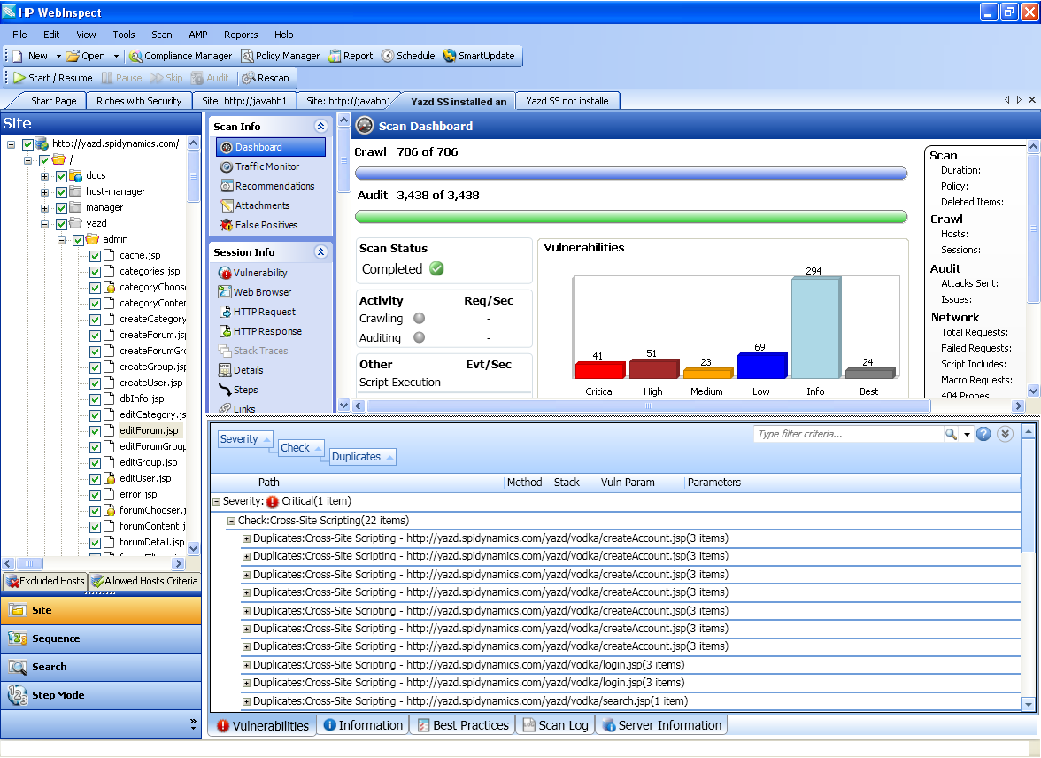
Attack surface identification
Hidden ‘admin’ area

Slide 35
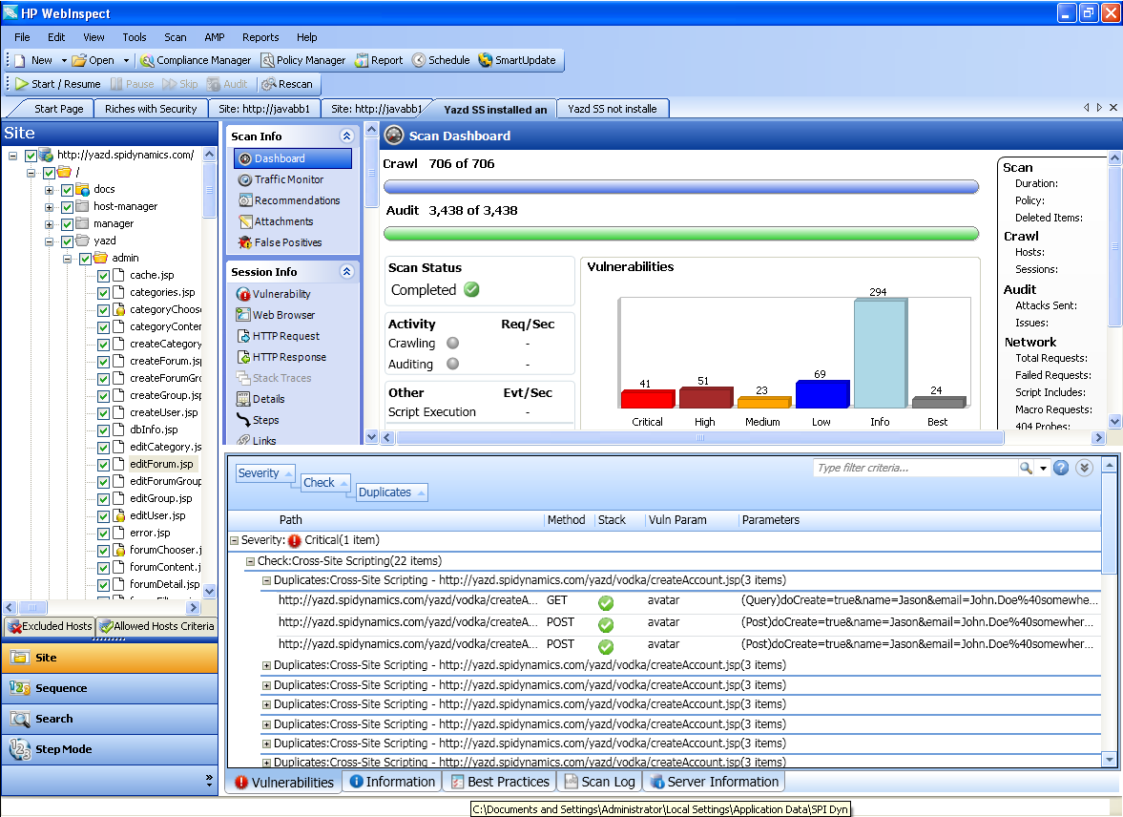
Group Common-Cause Issues

Slide 36
More to come: Automated anti-anti automation

Slide 37
Hater’s Club
Detecting attack surface statically doesn’t work
Correlating results doesn’t work
Doesn’t help with false positives and false negatives
Nobody will monitor the execution of the software

Slide 38
The Case for Gray-Box Testing
Automated security testing is critical
Black-box is a losing game, white-box is incomplete
Integrated analysis finds more
Attack surface
Types of vulnerabilities
Vulnerability diagnosis
Integrated analysis enables faster fixes
Root cause analysis
Group symptoms with a common cause

Slide 39
The Evolution of Software Security
Find More, Fix Faster
Brian Chess, Ph.D.
Distinguished Technologist, HP
Founder and Chief Scientist, HP Fortify

