Slide 1

Why do developers make dangerous software errors?
Michele Moss and Nadya Bartol
OWASP AppSec USA
September 23, 2011
Notes:
Booz Allen Hamilton Standard Colors
Colors should be used in the color pairs whenever possible. Do not mix and match colors, use pairs together as shown.
Black, White and Gray can be used with any of the other colors.
Purple
Pantone 2765
R 12
G 4
B 79
Green
Pantone
357
R 15
G 67
B 24
Blue
Pantone 2
88
R 11
G 31
B 101
Black
Pantone Cool Gray 6
R 158
G 158
B 158
Red
Pantone
485
R 252
G 5
B 14
Yellow
Pantone 3965
R 232
G 244
B 4
Aqua
Pantone
319
R 126
G 204
B 189
White

Slide 2
Key questions
Who asks developers to develop secure code?
Do developers know why they need to develop secure code?
What should developers do/not do to develop secure code?
Can developers develop secure code by themselves?
How do developers know they have developed secure code?
Why should developers care?
Next Steps?

Slide 3

Requirements for secure code are implicitly and not explicitly stated
What CIOs want
https://www.cioexecutivecouncil.com October 11, 2006 Press Release
Notes:
CIOs Call on Software Vendor Community to Improve Software Assurance
Complete Poll Results:
1. Overall, what is your level of confidence that software will function as intended and be free of flaws, security vulnerabilities and malicious code?
4% High (based on objective evidence, convinced that there are no flaws, security vulnerabilities or malicious code
44% Medium (based on objective evidence, reasonably sure there are no flaws, security vulnerabilities or malicious code)
52% Low (based on objective evidence, flaws, security vulnerabilities and/or malicious code are likely.)
0% Don’t know/unsure
2. Overall, how would you rate the fundamental security of software WITHOUT the use of firewalls, Intrusion Detection Systems (IDS), anti-virus scanners, etc.?
44% Extremely vulnerable
42% Vulnerable
10% Somewhat secure
4% Secure
0% Highly secure
0% Don’t know/unsure
3. Which of the following, if any, negative outcomes has your organization experienced as a result of flaws, security vulnerabilities or malicious code in software? (check all that apply):
61% Had to redeploy IT staff to deal with the problem(s)
59% Increased IT costs
56% Reduced IT productivity
49% Delayed projects
46% Unanticipated patch management costs and related business disruption
46% Reduced end-user productivity
38% Didn’t implement desired features or functions
37% Adverse impact on our customers (negative perception of us by customers or impact on
36% Limited the benefits IT could deliver to internal clients
11% None, we have had no negative experiences
our customer’s ability to do business with us)
11% Hindered ability to comply with regulations
2% Other (please write-in)
2% Don’t know/unsure
4. Of the following potential actions that a software vendor could take, which would be most effective in reassuring you that the vendor’s products will operate as intended and will be free from flaws, security vulnerabilities and malicious code? (check up to three)
73% Certify that software meets a designated security target
62% Provide evidence that software has been scanned for flaws and security vulnerabilities using qualified tools
48% Provide a list of known flaws and security vulnerabilities
36% Provide test cases for their software
29% Provide more transparency or visibility into their development process
10% Other
8% Provide information concerning the provenance of the code (e.g. where it was built, who it was acquired from, documentation of individuals who contributed to the code, etc.)
2% Don’t know/unsure
0% No additional information or actions by software vendors are needed
5. Of the following sources of information and/or methods, which do you routinely use to determine if software is free from flaws, security vulnerabilities and malicious code? (check all that apply)
85% Internal testing
65% Contract requirements and/or service level agreements (SLAs)
54% Reputation of the vendor and product among senior IT executives in other organizations
36% Third-party testing
35% Vendor statements or assurance claims
11% Comprehensive review of source code
8% Common Criteria evaluation (international evaluation standard)
0% Not applicable
0% Other
6. 6) Of the following, which software attributes are most important to your organization? (choose up to 3)
95% Reliable software that functions as promised
70% Software that is free from security vulnerabilities and malicious code
55% Ease of integration and configuration
32% Software that conforms to requirements and industry standards
27% Convenience and ease of use
11% Rich feature set
0% Other
0% Don’t know/unsure

Slide 4
  “Defacto” security requirements in NIST 800-53 do not explicitly require developers to produce secure code
Technical
  AC-2 Account Management
  AC-3 Access Enforcement
  AC-4 Information Flow Enforcement
Management
  RA-5 Vulnerability Scanning
Operational
  CM-7 Least Functionality
  SI-3 Malicious Code Protection
  SI-10 Information Input Validation

Slide 5
Technical controls in NIST 800-53 contribute to application security
  AC-7 Unsuccessful Login Attempts
  AC-10 Concurrent Session Control
  AC-11 Session Lock
  AC-14 Permitted Actions without Identification or Authentication
  AC - 16 Security Attributes
  AC-17 Remote Access
  AC-20 Use of External Information Systems
  AU-2 Auditable Events
  AU-3 Content of Audit Records
  AU-4 Audit Storage Capacity
  AU-9 Protection of Audit Information
  IA-3 Device Identification and Authentication
  IA-4 Identifier Management
  IA-5 Authenticator Management
  IA-6 Authenticator Feedback
  IA-7 Cryptographic Module Authentication
  IA - 8 Identification and Authentication (Non-Organizational Users)
  SC-2 Application Partitioning
  SC-3 Security Function Isolation
  SC-4 Information in Shared Resources
  SC-7 Boundary Protection
  SC-8 Transmission Integrity
  SC-10 Network Disconnect
  SC-11 Trusted Path
  SC-12 Cryptographic Key Establishment and Management
  SC-24 Fail in Known State
  SC-25 Thin Nodes
  AC-18 Wireless Access
  AC-19 Access Control for Mobile Devices
  SC-9 Transmission Confidentiality
  SC-13 Use of Cryptography
  SC-28 Protection of Information at Rest
  SC-23 Session Authenticity
  AC-5 Separation of Duties
  AC-6 Least Privilege

Slide 6
Operational controls in NIST 800-53 contribute to application security
  SI-1 System and Information Integrity Policy and Procedures
  SI-2 Flaw Remediation
  AT-2 Security Awareness
  AT-3 Security Training
  CM-3 Configuration Change Control
  CM-4 Security Impact Analysis
  CM-5 Access Restrictions for Change
  SI-4 Information System Monitoring
  SI-6 Security Functionality Verification
  SI-7 Software and Information Integrity
  CA-5 Plan of Action and Milestones
  RA-3 Risk Assessment
  SA-2 Allocation of Resources
  SA-3 Life Cycle Support
  SA-4 Acquisitions
  SA-6 Software Usage Restrictions
  SA-10 Developer Configuration Management
  SA-11 Developer Security Testing
  SA-12 Supply Chain Protection
  SA-13 Trustworthiness
  PM-1 Information Security Program Plan
  PM-3 Information Security Resources
  PM-6 Information Security Measures of Performance
  PM-7 Enterprise Architecture
  PM-9 Risk Management Strategy
  SA-8 Security Engineering Principles
  CM-6 Configuration Settings
  CM- 8 Information System Component Inventory
  SI-11 Error Handling
  SI-12 Information Output Handling and Retention

Slide 7
Key questions
Who asks developers to develop secure code?
Do developers know why they need to develop secure code?
What should developers do/not do to develop secure code?
Can developers develop secure code by themselves?
How do developers know they have developed secure code?
Why should developers care?
Next Steps?

Slide 8
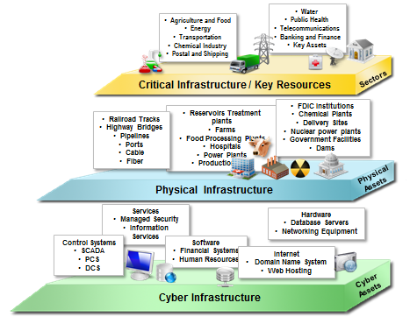
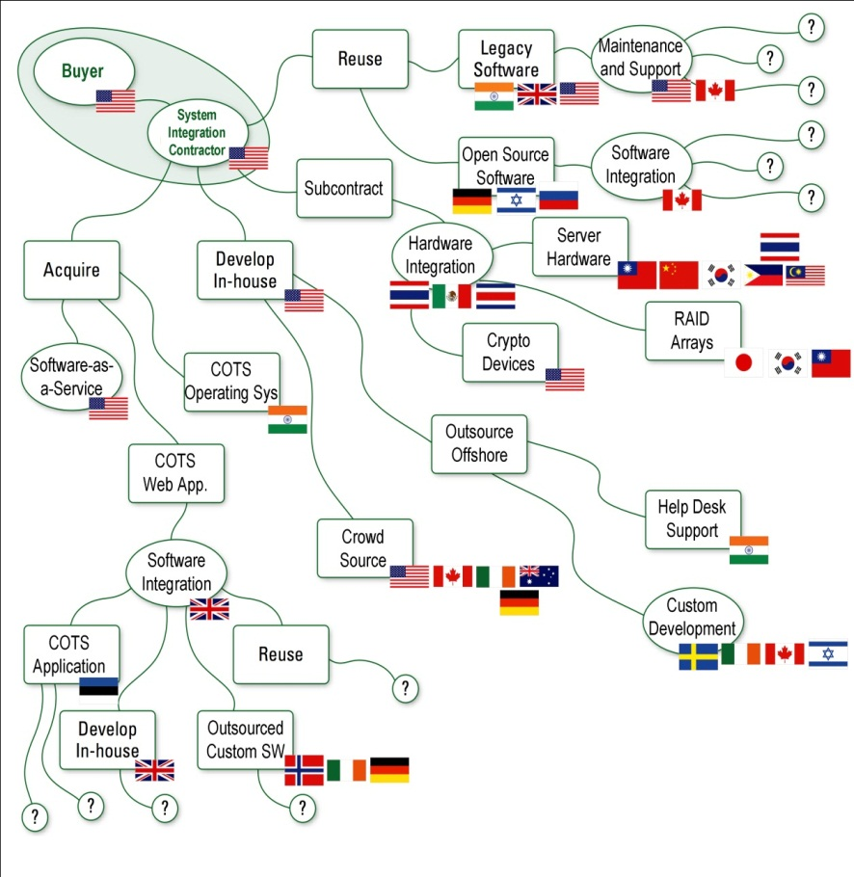
Perspective on technology today
IT and Communications products are assembled, built, and transported by multiple vendors around the world
Technology is an integral part of our lives

Slide 9
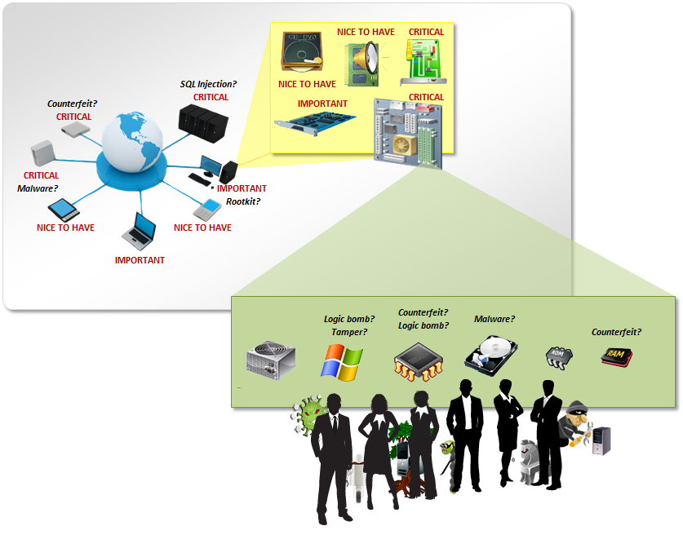
Malicious actors are taking advantage of abundant opportunities to tamper with and sabotage products …
What commonalities exist? | 83% of victims were targets of opportunity 92% of attacks were not highly difficult 86% were discovered by a third party 96% of breaches were avoidable through simple or intermediate controls
How do breaches occur? | 50% utilized some form of hacking 49% incorporated malware (lower percentages included physical attacks, privilege misuse, and social tactics)
* Source – 2011 Verizon Data Breach Investigations Report
… ultimately compromising system integrity and operations

Slide 10
SwA requires multi-disciplinary collaboration
Project
Management
ISO/IEEE 15288
ISO/IEC 27000
System
Engineering
Information Assurance
Communication
Challenges
CMMI
Common Criteria
Vocabulary
Reserved Words
Priorities
Perspective
Experience
Objectives
Drivers
Risks
Software Acquisition
Software
Assurance
Software
Engineering
ISO/IEEE 12207
Test &
Evaluation
Information Systems Security Engineering
Safety and Security
Source: https://buildsecurityin.us-cert.gov/swa/procresrc.html
Without a common language we cannot communicate across disciplines

Slide 11
Acquirers of IT products and services trust that suppliers are addressing cyber security without validating
Prepare for the acquisition
Advertise the acquisition and select the supplier
Initiate an agreement
Monitor the agreement
Accept the product or service
Product Development and Maintenance
Requirements Management
Design/Develop
Test
47% do not perform acceptance testing of third-party code
30% do not use static analysis/manual code
27% do not practice secure design
19% do not carry out security requirement definition
46% use own development method, rather than SDL or CMM/CMMI
15% follow SDL
20% follow CMM/CMMI ®
61% had no special incentive program to get developers and testers to work together
More than 70% do not measure developers with security related metrics
  ROI was greater for those who employed a coordinated, prescriptive approach
Source: Forrester, “State of Application Security,” January 2011

Slide 12
Key questions
Who asks developers to develop secure code?
Do developers know why they need to develop secure code?
What should developers do/not do to develop secure code?
Can developers develop secure code by themselves?
How do developers know they have developed secure code?
Why should developers care?
Next Steps?

Slide 13
Communication across organizational stakeholders is critical to addressing SwA challenges
Development Project
DP 1 Identify and manage risks due to vulnerabilities throughout the product and system lifecycle
DP 2 Establish and maintain assurance support from the project
DP 3 Protect project and organizational assets
Enterprise Assurance Support
ES 1 Establish and maintain organizational culture where assurance is an integral part of achieving the mission
ES 2 Establish and maintain the ability to support continued delivery of assurance capabilities
ES 3 Monitor and improve enterprise support to IT assets
Define Business Goals
Development Organization
DO 1 Establish the assurance resources to achieve key business objectives
DO 2 Establish the environment to sustain the assurance program within the organization
Prioritize funds and manage risks
Acquisition and Supplier Management
AM 1 Select, manage, and use effective suppliers and third party applications based upon their assurance capabilities.
Development Engineering
DE 1 Establish assurance requirements
DE 2 Create IT solutions with integrated business objectives and assurance
DE 3 Verify and Validate an implementation for assurance
Sustained environment to achieve business goals through technology
Enable
Resilient Technology
The Assurance PRM Is A Holistic Framework that connects CMMI and RMM to facilitate communication
https://buildsecurityin.us-cert.gov/swa/proself_assm.html

Slide 14
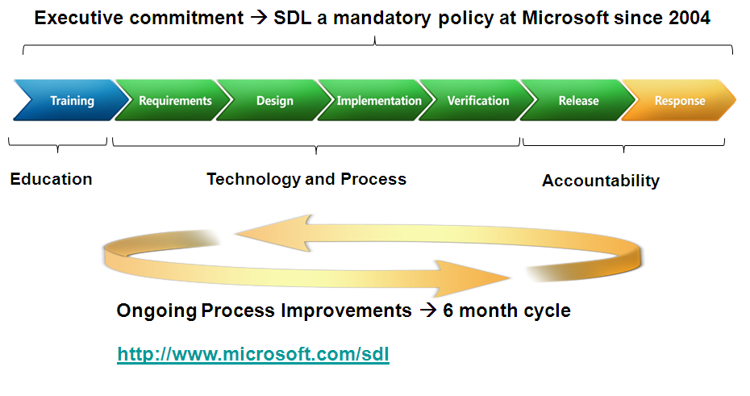
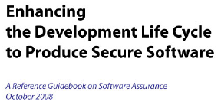
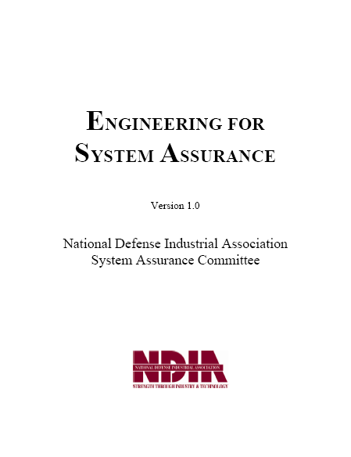
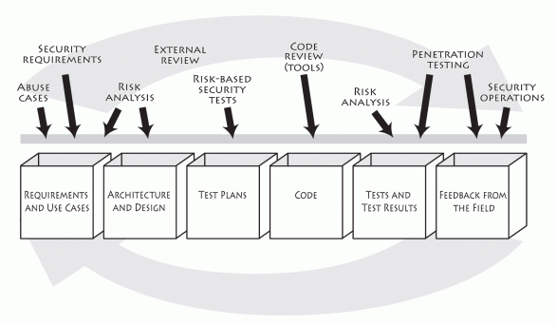

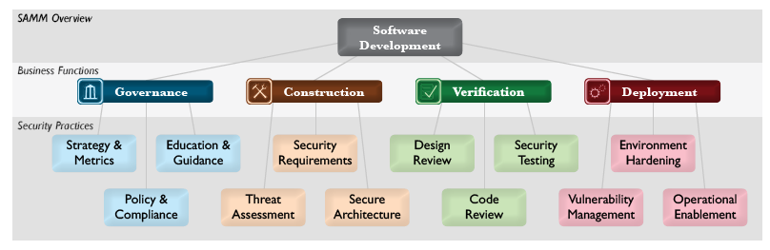
A majority of SwA best practices focus on developer-centric audiences from a security point of view
Development Project
DP 1 Identify and manage risks due to vulnerabilities throughout the product and system lifecycle
DP 2 Establish and maintain assurance support from the project
DP 3 Protect project and organizational assets
Development Engineering
DE 1 Establish assurance requirements
DE 2 Create IT solutions with integrated business objectives and assurance
DE 3 Verify and Validate an implementation for assurance
Development Organization
DO 1 Establish the assurance resources to achieve key business objectives
DO 2 Establish the environment to sustain the assurance program within the organization
Assurance for CMMI ®

Slide 15
Key questions
Who asks developers to develop secure code?
Do developers know why they need to develop secure code?
What should developers do/not do to develop secure code?
Can developers develop secure code by themselves?
How do developers know they have developed secure code?
Why should developers care?
Next Steps?

Slide 16
100 apps written by 100 developers at 100 companies
We Trust
We Hide
We Blame
83 apps have serious vulnerabilities
72 apps have cross site scripting
40 apps have SQL Injection
100 apps contain code of unknown origin
90 apps use un-patched libraries with known flaws
5 apps have had a scan or pentest
1 app has had a manual security code review
0 apps provide any visibility into security
Why
1 company has a responsible appsec program
1 developer has any security training
Adapted from: The Open Web Application Security Project ,Jeff Williams, Aspect Security, SWA Forum Sept 2010

Slide 17
Implementation lessons learned from some of the 1/100 companies that implement SwA successfully
Who
  Secure development SMEs
  Developers
What
  Measure progress (training, secure code reviews, security change requests)
  Internal policy
When
  During product development process
  During Leadership discussions
  As part of development and acquisition reviews
Where
  IT Development Organizations
  IT Acquisition Organizations
  IT Integrator Organizations
Why
  Customer pressure
  Reaction to an incident
Why Not
  Compliance drivers don’t exist
  Focus is on systems and networks
  Secure software training is not given to developers and architects
How
  Executive leadership commitment
  Translate ROI to project manager vocabulary (cost, schedule, quality)
  Start small and build
  Use coding standards
  Empower secure development to prevent a product from moving to the next milestone
  Avoid creating a new language
  Leverage what is already known
  Increase automation of menial tasks
Courtesy of September 2010 SwA Panel SwA Practices
– Getting to Effectiveness in Implementation

Slide 18
Key questions
Who asks developers to develop secure code?
Do developers know why they need to develop secure code?
What should developers do/not do to develop secure code?
Can developers develop secure code by themselves?
How do developers know they have developed secure code?
Why should developers care?
Next Steps?

Slide 19
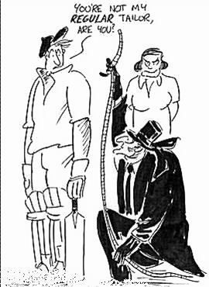
Measure, measure, and measure again
"The only man I know who behaves sensibly is my tailor; he takes my measurements anew each time he sees me. The rest go on with their old measurements and expect me to fit them."
- George Bernard Shaw
Source: www.CartoonStock.com

Slide 20

Robust measurement does not happen overnight and requires foundational capabilities in place to be effective
Add Essential Monitoring and Controls
Develop Timeliness, Accuracy, Coverage
Continuous Operational Monitoring Supports Response
---
Maintain, and Improve Security
Efficiency/Effectiveness
Prepare Foundation
Develop Capability
Use Capability
Goal
Metric Type
Implementation
Metric
Effectiveness Metric
Impact
Metric
Courtesy of Matt Coose, DHS

Slide 21
Critical success factor – long-term management commitment, focus, and appropriate expectations
Problem
Solution
Senior management has not expressed explicit support for the program
There is no long term funding and resource commitment
There is a perception in the organization that measurement and monitoring are temporary and “will be done” at some point
Security improvements are expected within a very short time period and are expected to be easily directly related to measurement and monitoring
Program is expected to be perfectly planned and executed as if the organization has done this a million times and has the process down perfectly
Turnover and changes in roles breaks up continuity
Accountability for metrics is difficult to assign
Obtain senior management commitment before you start
Work across the organization with the stakeholders to make them a part of the solution
Iterate the program to measure critical things
Structure the program to begin with quick wins to continuously demonstrate increase in value
Manage expectations continuously – explain that the long term focus is critical
Assign roles, train your responsible parties, and communicate that continuity is key for success
Emphasize positive reinforcement – if everyone is failing, nobody will cooperate and the program will fail

Slide 22
Critical success factor – realistic and well thought out data collection strategy
Problem
Solution
Data sources not well known, well defined, and therefore not considered
Desired data is not obtainable
Automated data sources are dispersed throughout the organization and data is difficult to consolidate
Authoritative data sources do not exist
Data is collected inefficiently or incorrectly
Collection deemed too difficult too early
Difficulty or inability to capture historical data
Identify all available automated and manual data sources
Define data that you need and compare with what available
Create data collection strategy that would balance the need for data with the current state and plan for deliberately expanding data sources and measures
Define future changes to processes/tools or requirement for new tools early in the process and refresh as you learn more
Use feasibility of data collection as one of the criteria for metrics selection
Train your data collectors and information owners about what you need and then ask for it repeatedly

Slide 23
Critical success factor – effective use of the measures to improve security
Problem
Solution
Metrics analysis is not prioritized according to strategic goals, risks, ROI, or other explicit criteria agreed upon by the organization
Wrong types of measures are distributed to wrong stakeholders
Measures are collected for compliance and are not used to improve security
Metrics data is not used for risk-based decision making
Develop criteria for prioritizing and scoring measures early in the program and reconsider every time you expand the program
Define who gets what data and reassess periodically – ask your customers if it is still useful
If metrics are not used for decision making and improvement, drop them
Communicate, communicate, communicate

Slide 24
Security control measures
Percent of new systems that have completed certification and accreditation (C&A) prior to their implementation (NIST SP 800-53 Control: CA-6: Security Accreditation)
Percent of employees who are authorized access to information systems only after they sign an acknowledgement that they have read and understood rules of behavior (NIST SP 800-53 Controls – PL-4: Rules of Behavior and AC-2: Account Management)
Percent of the agency’s information system budget devoted to information security (NIST SP 800-53 Controls – SA-2; Allocation of Resources)
Security Control Measures address compliance with the end state of the system, but not the underlying processes, structures, and code

Slide 25
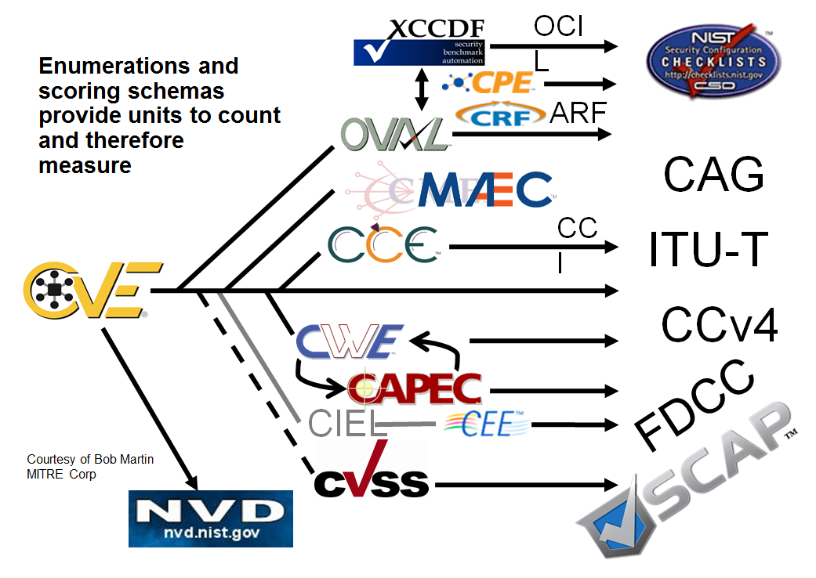
Measurement for secure code requires understanding code level attributes …

Slide 26
Measurement for secure code involved understanding the effectiveness of implemented processes
Acquisition
  Number and percent of acquisition discussions that include SwA representative
  Number and percent of contracting officers who received training in the security provisions of the FAR
  Percent of documented Supplier claims verified through testing, inspection, or other methods
  Number and percent of relevant high impact vulnerabilities (CVEs) present in the system
Testing
  Number and percent of tests that evaluate application response to misuse, abuse, or threats
  Number and percent of tests that attempt to subvert execution or work around security controls
  Percent of untested source code related to security controls and SwA requirements

Slide 27
How to apply…. success is simple
Get Management Support
Start Small
Measure Behavior
Scope out measurement
Obtain tangible support for security measures development and use at every management level
Maintain support through regular reporting to stakeholders, tailored to their levels
  Address their goals
  Refine detail further up the management chain
  Use Dashboards & Reports to endure
Expand your project/program cost, schedule, quality, and growth measures to cover security
Start with a manageable, small set of security measures adding more measures as the project matures
Leverage existing industry lists and select applicable measures
Use a framework to translate measures from industry lists into your organization’s approach
Train data collectors to think in terms of metrics
Identify and measure best and worst process and practice behaviors as well as results
Create, display, and report measures to influence appropriate behavior
Take advantage of unintended consequences produced by measurement
Reuse measures where possible
Incorporate security measures into your existing measurement activities
Source: http://www.psmsc.com/Downloads/TechnologyPapers/SwA%20Measurement%2010-08-08.pdf, accessed 4/10/09
Notes:
Start with basics. Software measurement will generally address:
Cost
Schedule
Quality
Growth
As we will see later, goals drive measurement. Start with a manageable, small set of measures
As the project learns how the measurement cycle works, it also learns how to make the process more efficient as it adds new goals and measures
Growing measurement in this way eliminates rework, since many initial measures, improperly imposed at the outset, must be eliminated and replaced

Slide 28
Key questions
Who asks developers to develop secure code?
Do developers know why they need to develop secure code?
What should developers do/not do to develop secure code?
Can developers develop secure code by themselves?
How do developers know they have developed secure code?
Why should developers care?
Next Steps?

Slide 29





Business functions rely on accurate and reliable information from technology that functions as intended (and only as intended)
X
X
X
Organization Mission
Business Processes
X
Service Mission
Service
Service Mission
Service Mission
X
Assets in Production
people
info
tech
facilities
Adapted from: November 2009 SwA Forum-Evolution in SwA Processes Panel – David White, SEI

Slide 30




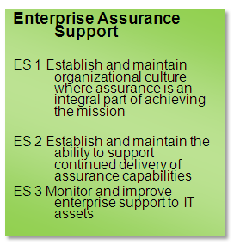

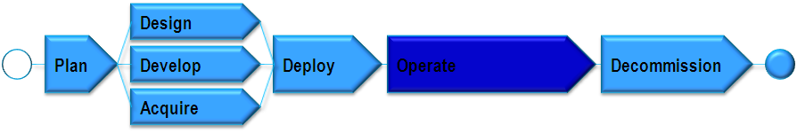
Potential impacts from threats to business functions can be understood by communicating software level vulnerabilities
MAEC
Are we being attacked?
Compliance
OVAL
SCAP
Incident Management and Control
Apply Lessons Learned
CAPEC
How do we prevent this next time?
CVSS, CAPEC MAEC, KDM
Resilience Requirements Management
Monitoring
Enterprise Focus
Who is attacking and what do they want?
BPMN
Applied to
Measurement and Analysis
Vulnerability Analysis and Resolution
Controls
Applied to
Asset Management
Are we at risk?
Adapted from September 2010 SwA Forum, CERT RMM for Assurance , Lisa Young, SEI

Slide 31
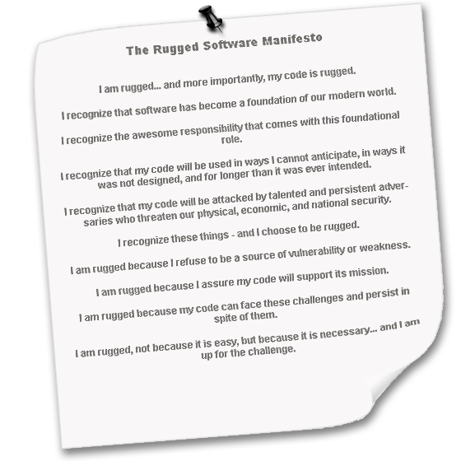
http://www.ruggedsoftware.org/

Slide 32
Key questions
Who asks developers to develop secure code?
Do developers know why they need to develop secure code?
What should developers do/not do to develop secure code?
Can developers develop secure code by themselves?
How do developers know they have developed secure code?
Why should developers care?
Next steps?

Slide 33
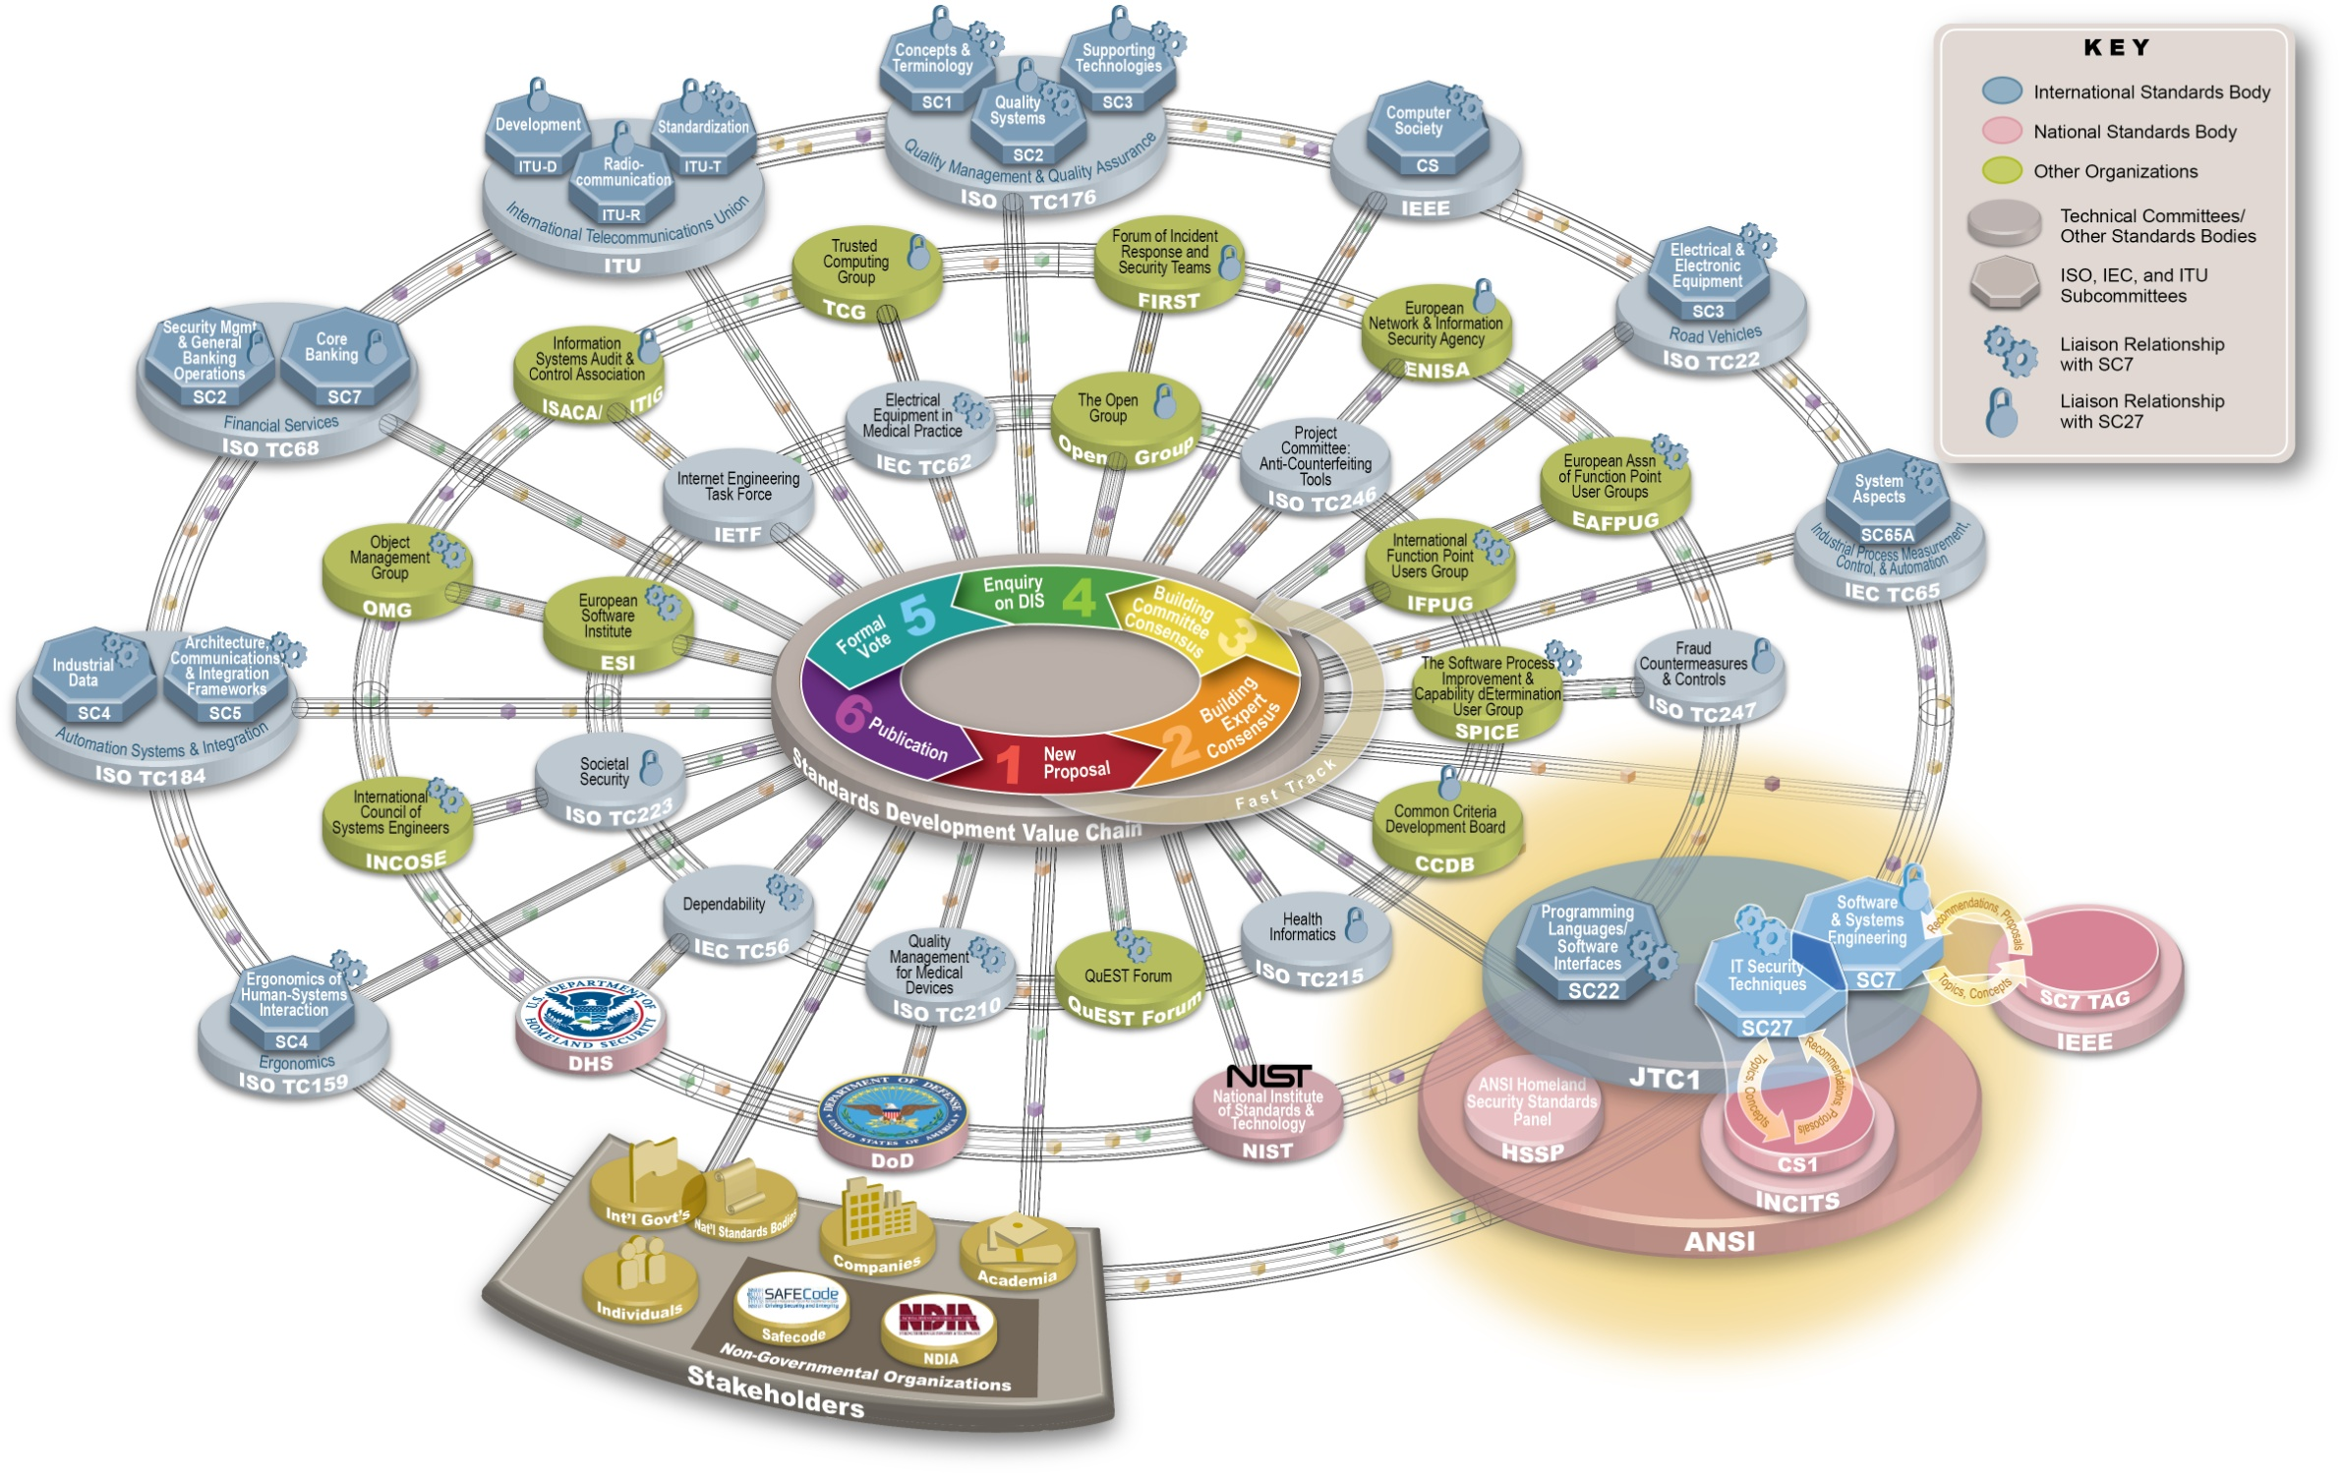
Cyber security and software assurance standard development organization landscape

Slide 34
SC22 – Programming Languages, ISO/IEC TR 24772, Programming Language Vulnerabilities
Targets building software that is inherently less vulnerable through improving the programming languages, or, at least, improve the usage of them in coding
A catalog of 60+ issues that arise in coding when using any language and how those issues may lead to security and safety vulnerabilities
Cross-referenced to CWE
Each discussion includes
  Description of the mechanism of failure
  Recommendations for programmers: How to avoid or mitigate the problem.
  Recommendations for standardizers: How to improve programming language specifications.
Courtesy of Jim Moore, MITRE

Slide 35
ISO/IEC 27036: Information technology – Security techniques –Information Security for Supplier Relationships
Scope: This international standard covers information security in relationships between acquirers and suppliers to provide appropriate information security management for all parties. In particular, it also includes management of information security risks related to these relationships.
The standard will be subdivided into the following parts:
  Part 1 – Overview and Concepts
  Part 2 – Common Requirements
  Part 3 – Guidelines for ICT Supply Chain
  Part 4 – Guidelines for Outsourcing

Slide 36
NIST IR 7622, Piloting Supply Chain Risk Management for Federal Information Systems
Initially based on DoD ICT SCRM Key Practices document and developed in close collaboration with the industry
Introduces the notion of supply chain players
  Acquirer - For this document, the acquirer is always a government agency (including those agencies taking on the role of integrator).
  Integrator – A third-party organization that specializes in combining products/elements of several suppliers to produce elements (information systems).
  Supplier – Third-party organization providing individual elements. Synonymous with vendor and manufacturer; also applies to maintenance/disposal service providers
Lays out pre-requisites of being able to address ICT SCRM challenge
States specific practices that are consistent with DoD guidance and ISO frameworks

Slide 37
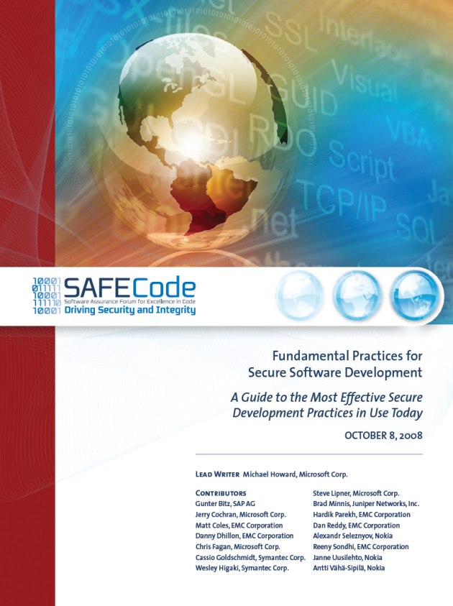
SAFECode (www.safecode.org)
SAFECode is a global, industry-led effort to identify and promote best practices for developing and delivering more secure and reliable software, hardware and services
White papers
  Software Assurance: An Overview of Current Industry Best Practices
  Fundamental Practices for Secure Software Development
  Security Engineering Training: A Framework for Corporate Training Programs on the Principles of Secure Software Development
  Framework for Software Supply Chain Integrity
  Software Integrity Controls: An Assurance-Based Approach to Minimizing Risks in the Software Supply Chain

Slide 38
The Open Group
Trusted Technology Provider Framework (TTPF)
Purpose
Identify and gain consensus on common processes, techniques, methods, product and system testing procedures, and language to describe and guide product development and supply chain management practices that can mitigate vulnerabilities which could lead to exploitation and malicious threats to product integrity.
Objectives
  Identify product assurance practices that should be expected from all commercial technology vendors based on the baseline best practices of leading trusted commercial technology suppliers
  Help establish expectations for global government and commercial customers when seeking to identify a trusted technology supplier
  Leverage existing globally recognized information assurance practices and standards
  Share with commercial technology consumers secure manufacturing and trustworthy technology supplier best practices
  Harmonize language used to describe best practices
Source: Source: September 28, 2010 SwA Forum, DoD Trusted Defense Systems, Ms. Kristen Baldwin, DDR&E/Systems Engineering

Slide 39
What’s next?
Continued collaboration to:
  Reach and enable developers
  Reach and enable executives
  Develop and promote resources for us by developers and executives
Participation in international standardization efforts
  SC7 TAG intersections through your SC7 TAG
  CS1/SC27
  IEEE representative to the SC7 TAG
  SC22
Participation through the SwA Working Groups and Forum
Stay Tuned …

Slide 40
Contact information
Nadya Bartol
Senior Associate
Michele Moss
Lead Associate
Booz Allen Hamilton Inc.
One Preserve Parkway
Rockville, MD 20852
Tel (301) 444-4114
bartol_nadya@bah.com
Booz Allen Hamilton Inc.
8283 Greensboro Drive
Mclean, VA 22102
Tel (703) 377-1254
moss_michele@bah.com

