Slide 1
Brakeman and Jenkins: The Duo Detects Defects in Ruby on Rails Code
Justin Collins
Tin Zaw
AppSec USA
September 23, 2011

Slide 2
About Us
Justin Collins - @presidentbeef
Tin Zaw - @tzaw

Slide 3
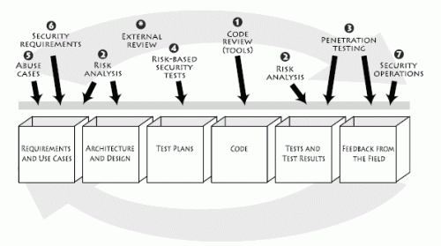
McGraw’s Touch Point #1 Code Review (Tools)

Slide 4
Our Philosophy: Light Touch
Use tools to detect and report
security defects in code
early in the development cycle
with minimal impact
to development workflow

Slide 5
Static vs. Dynamic Analysis
Penetration Testing Pros
Replicates real life deployment
Entire application stack, configuration
Penetration Testing Cons
Reports symptoms, not root causes
Setup time, find defects late during QA cycle
Incomplete view of running app

Slide 6
Static vs. Dynamic Analysis
Static Code Analysis Pros
Early detection of defects
Integrated into developer’s workflow
No deployment required
Static Code Analysis Cons
Limited to code
Need access to source code

Slide 7
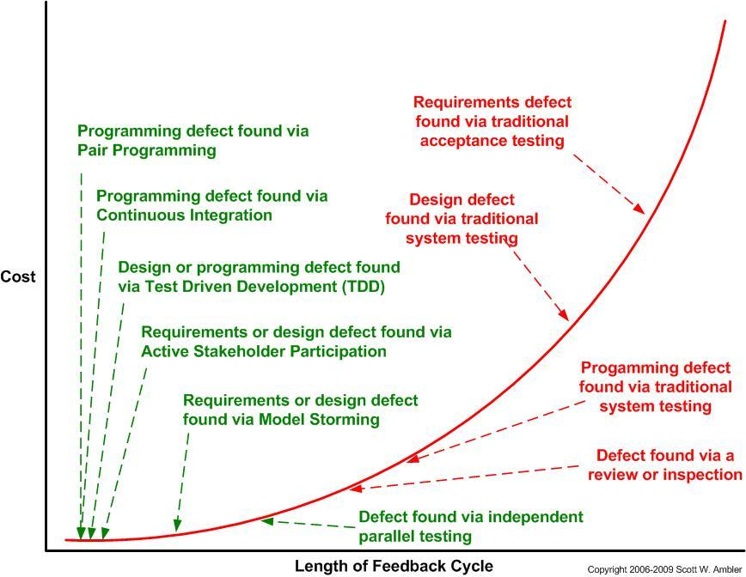
Defect Cost Curve

Slide 8
Defect Cost Curve
Application Security Testing

Slide 9
Defect Cost Curve
Brakeman
+
Jenkins

Slide 10
Existing Static Analysis Tools for Security Defects
C/C++ | <many>
C#/.Net | <many>
Java | <many>
Ruby | ?
Ruby on Rails

Slide 11
Ruby on Rails
http://rubyonrails.org/
Web application framework using the Ruby language
Built on the model-view-controller design pattern
“Convention over configuration” – encourages assumptions which lead to default behavior

Slide 12
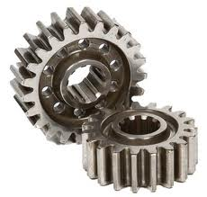
Manual Workflow
Get Latest Code
Run Tool
Examine Results

Slide 13
Manual Workflow
Get Latest Code
Run Tool
Examine Results
Repeat

Slide 14
Automated Workflow
Let tools alert you when there is a problem

Slide 15
Brakeman
http://brakemanscanner.org

Slide 16
Using Brakeman
gem install brakeman
cd your/rails/app
brakeman

Slide 17
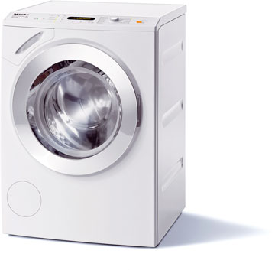
Brakeman Application Flow
Parse App Code
Clean up &
Organize
Inspect
Results
Generate
Report

Slide 18
Vulnerabilities Brakeman Detects
Cross site scripting
SQL injection
Command injection
Unprotected redirects
Unsafe file access
Default routes
Insufficient model validation
Version-specific security issues
Unrestricted mass assignment
Dangerous use of eval()
…and more!

Slide 19
Example: Cross Site Scripting (Rails 2.x)
<b>Results for <%= params[:query] %></b>

Slide 20
Example: Cross Site Scripting (Rails 3.x)
<b>Results for <%= raw params[:query] %></b>

Slide 21
Example: Cross Site Scripting (Rails 3.x)
<b>Results for <%= raw params[:query] %></b>
Unescaped parameter value near line 1: params[:query]

Slide 22
Example: SQL Injection
username = params[:user][:name]
User.find(:all,
:conditions => "name like '%#{username}%'")

Slide 23
Example: SQL Injection
username = params[:user][:name]
User.find(:all,
:conditions => "name like '%#{username}%'")
Possible SQL injection near line 87:
User.find(:all, :conditions => ("name like '%#{params[:user][:name]}%'")

Slide 24
Extended Example - Filters
class ApplicationController < ActionController::Base
def set_user
@user = User.find(params[:user_id])
end
end
Method in application controller sets the @user variable

Slide 25
Extended Example - Filters
class UserController < ApplicationController
before_filter :set_user
def show
end
end
User controller calls set_user before any action

Slide 26
Extended Example - Filters
<%= raw @user.bio %>
View outputs the result of a method call on the @user variable

Slide 27
Extended Example - Filters
UserController
ApplicationController
UserController
user/show.erb.html
Data flow followed from filter through to the view

Slide 28
Extended Example - Filters
<%= raw @user.bio %>
Unescaped model attribute near line 5: User.find(params[:id]).bio

Slide 29
Example: Mass Assignment
class User < ActiveRecord::Base
end
User model generated by Rails

Slide 30
Example: Mass Assignment
class UsersController < ApplicationController
#...
def new
@user = User.new(params[:user])
#...
end
end
Excerpt of Users controller generated by Rails

Slide 31
Example: Mass Assignment
class UsersController < ApplicationController
#...
def new
@user = User.new(params[:user])
#...
end
end
Unprotected mass assignment near line 43: User.new(params[:user])

Slide 32
Open source continuous integration server
http://jenkins-ci.org

Slide 33
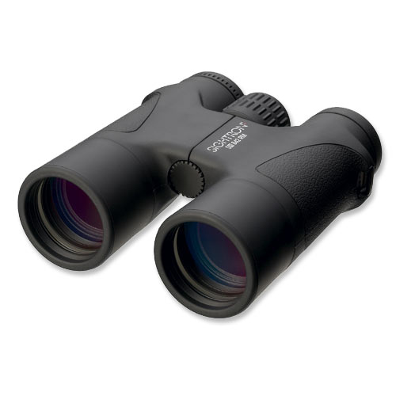
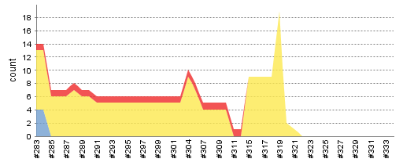
How Jenkins Works
Monitor Conditions
Run Jobs
Aggregate Results

Slide 34
How Jenkins Works
Monitor Conditions
Run Jobs
Aggregate Results
git push
svn commit
brakeman
Security Warnings

Slide 35
Brakeman Plugin for Jenkins
Run Brakeman
Collect
Warnings
Generate
Reports

Slide 36
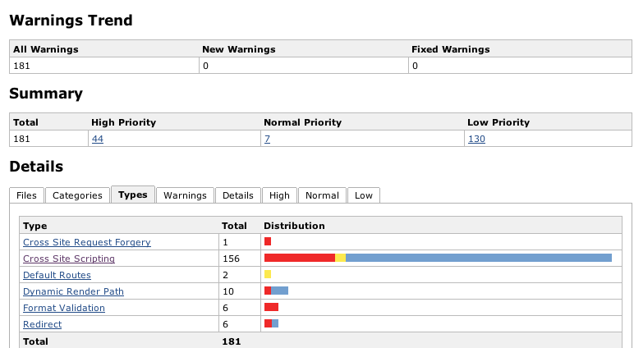
Some Results

Slide 37
Resources
Ruby
http://ruby-lang.org
Ruby on Rails
http://rubyonrails.org
Ruby on Rails Security Guide
http://guides.rubyonrails.org/security.html
Brakeman
http://brakemanscanner.org
Jenkins
http://jenkins-ci.org
Brakeman plugin for Jenkins
http://github.com/presidentbeef/brakeman-jenkins-plugin

