Slide 1
Android Security, or This is not the kind of "Open" I Meant...

Slide 2
Who Am I
Mike Park
Senior Security Consultant, Application Security, Trustwave SpiderLabs

Slide 3
Topics
What we’ll cover
The Basics
Setup for Testing
Reverse Engineering
Proxy and Hack
Tips and Tricks
Solutions?
Conclusions

Slide 4
The Basics

Slide 5
The Basics
What are people doing here?
Stealing Money and information
Embarrassing people
Getting famous
Breaking out of restrictive application licensing and functionality
For the lulz…
Notes:
Talk about what people are currently doing with broken Android apps, talk about the large amount of press Android apps have been getting
Stealing money, increasing payment apps on mobile devices, this increases the chances of a criminal translating an Android compromise into a direct monetary payout, increasing the stakes – variants of Zeus\Zbot banking trojan found on Android.
Embarrassing people, PR nightmare to be a paypal type company where your app flaws are publicly exposed, need to get in there to close those holes before someone else finds them.
Independent security researchers are doing this work in an effort to make a name for themselves.
Breaking out of restrictive licensing schemes and functionality - user’s braking out of Kobo software etc to read multiple e-book formats on their devices is an example of both

Slide 6
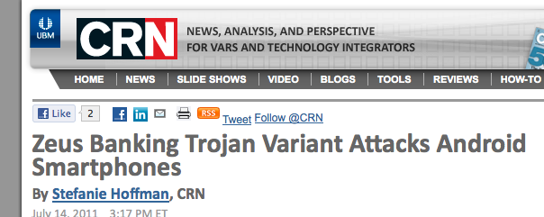
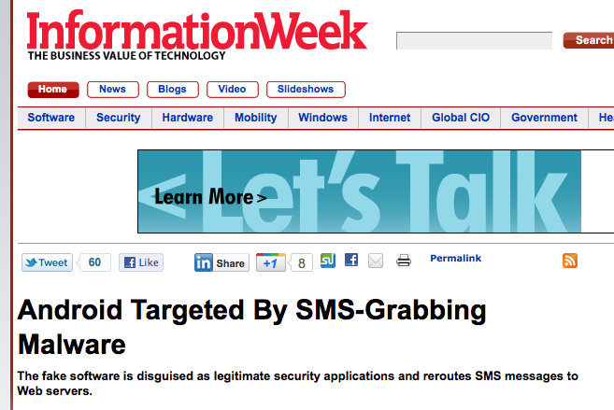
The Basics
Android Apps In the Press
http://www.crn.com/news/security/231001820/zeus-banking-trojan-variant-attacks-android-smartphones.htm;jsessionid=-TgAxjI7e80mqk7RCslbcQ**.ecappj01
http://www.informationweek.com/news/231001918
Notes:
Zeus banking trojan is turning up on Android smartphones in an effort to outwit 2 factor auth.
SMS grabbers do the same thing, to either steal credentials or to send high-cost texts, premium subscription SMS services.
Both cases the user is social engineered into installing a trojan, ironically often trojaned copies of legit applications like anti-virus or banking security suites, often added to the Android Market place or third party markets…

Slide 7
The Basics
How are we doing this?
Developers aren't aware of best practices.
Developers are unaware of the underlying platform
User’s don’t even have security on their radar
User’s are easily social engineered
Notes:
Talk about why iphone apps are in the news and why its bad if they are poorly written.

Slide 8
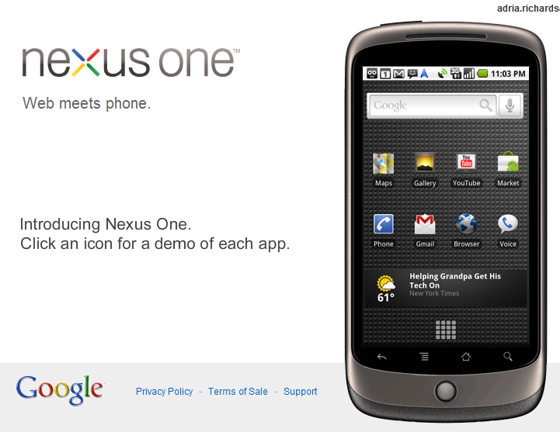
The Basics
Remember:
Today’s smartphone is the same as the Desktop we used in 2000, but with better graphics, more memory and better connectivity.
Creative Commons:￼￼ Some rights reserved by adria.richards
Creative Commons: Some rights reserved by Brandon Stafford
Notes:
Talk about why iphone apps are in the news and why its bad if they are poorly written.

Slide 9
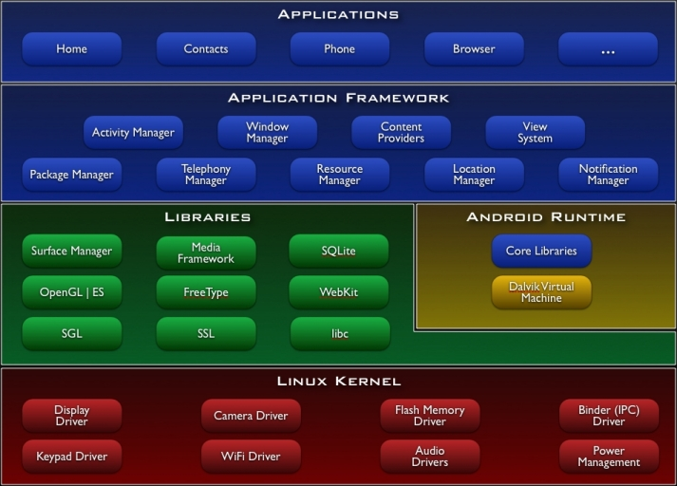
The Basics
Android Architecture:
From Google via the Google content license - http://developer.android.com/license.html
Notes:
Talk about Android Architecture – Linux ARM kernel OS with Dalvik VM on top
Apps written in Java (unliess you add stuff with the NDK)
Apps packaged as .apk, which is just a jar file with some extra manifest information
Important because unless its obfuscated well, you can get near perfect java code out.

Slide 10
The Basics
What are we focusing on:
Android .apk apps only
Not Browsers
Not Android OS, unless the app leads directly to rooting
Not hardware
What is different from traditional app pentesting
Like a regular web app pentest, except you need to test the browser (the app) as well as the server.
The data to be compromised may be on the device as well as the server.
Notes:
Talking about Android apps! Not browsers, not OS, just apps you get from the Android Market or other market. OS is an entire subject alone We touch on OS issues only if they lead to rooting as the result of an application compromise or if its important in setting up a test environment..
Usually when doing an app pentest, we don’t care much about the clients side, except for XSS… For this, we need to care – vulns could be in the client, as could insecurely stored data or credentials. Or a way for an attacker to root your device..

Slide 11
Setting Up Your Test Environment

Slide 12
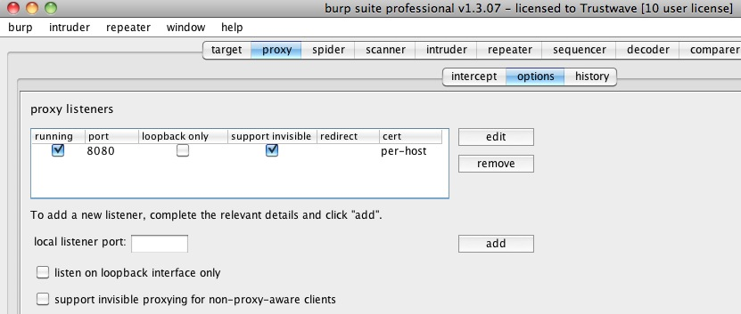
Test Setup
On the computer being used for testing
Step 1: Configure Proxy Options
Notes:
This is the initial setup used in burp suite in order to begin to intercept the apps communications

Slide 13
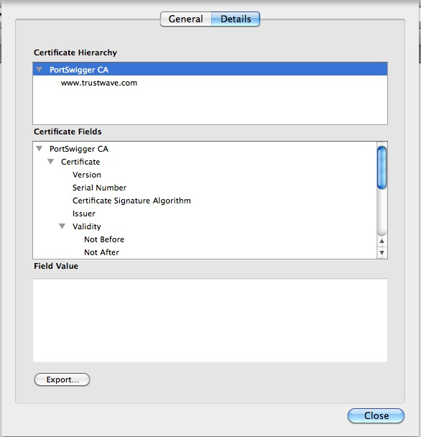
Test Setup
On the computer used for testing
Step 2: Extract the CA cert
Notes:
Extract the CA cert from the browser cert chain which is displayed when the proxy is used to intercept a page using SSL.

Slide 14
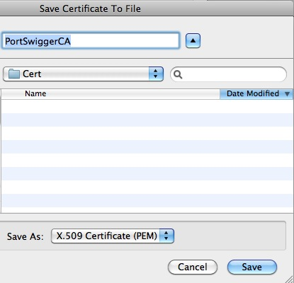
Test Setup
On the computer being used for testing
Step 3: Export the Certificate
Notes:
Export the certificate as an x.509 .pem certificate, you must use . PEM format to import the certs into the Android emulator.

Slide 15
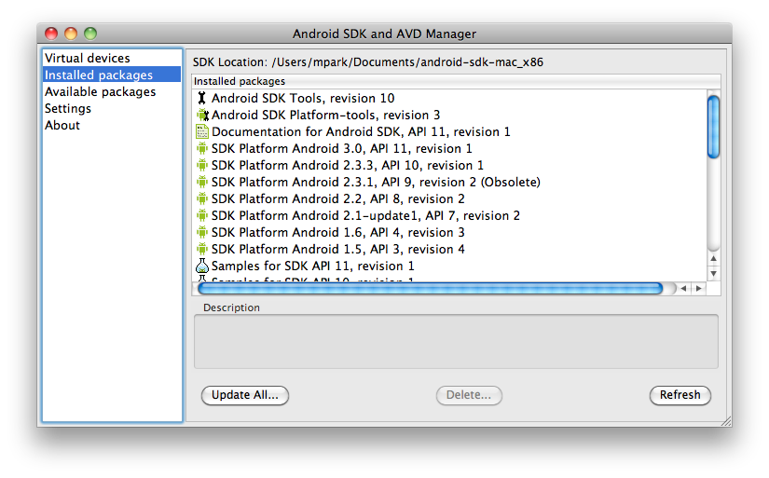
Test Setup
On the computer being used for testing
Step 4: Install and setup the Android SDK – install as much of the APIs as you can http://developer.android.com/sdk/index.html
Notes:
Ensure you have the latest Android SDK installed, including as many of the APIs as you can. Be patient…this takes a while…

Slide 16
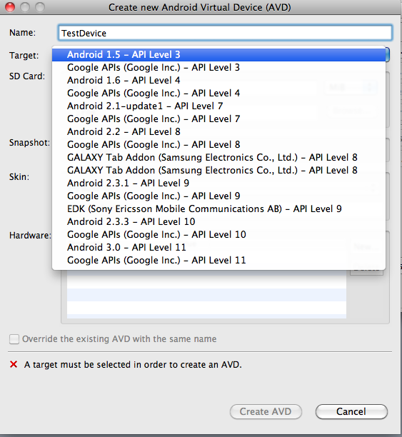
Test Setup
On the computer being used for testing
Step 5: Create a target Android Virtual Device (AVD)
Notes:
The Target AVD is the virtual device you will be proxying through burp and testing your apps on. We need to do a few extra steps to get this going, but start off. Basically you want to target the right SDK version. A good one is the 2.2 release, with at least 1024 SD card. Create the AVD, start it up, then shut it down.

Slide 17
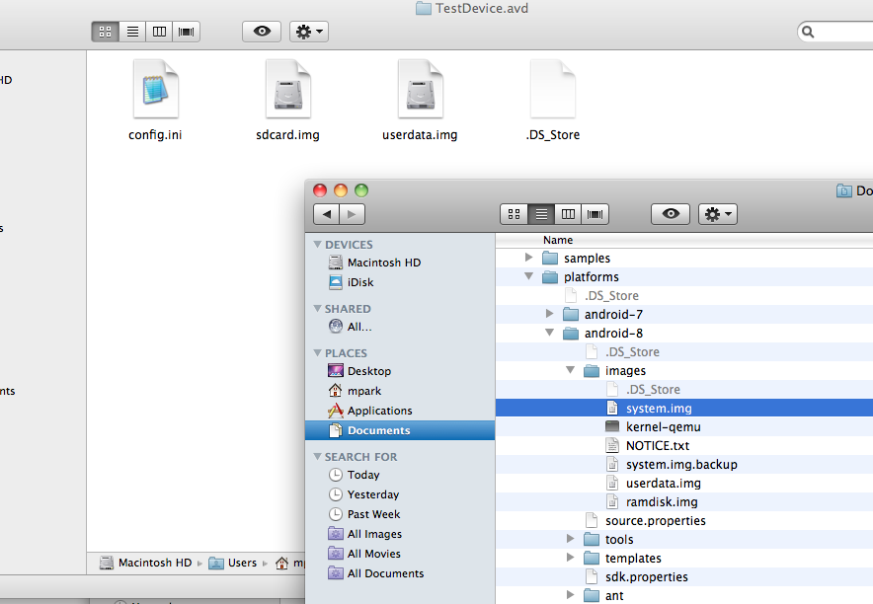
Test Setup
On the computer being used for testing
Step 6: Copy the system.img from the android-sdk-mac_x86/platforms/android-8 (or whatever API version you used) to your ~/.android/avd/TestDevice.avd (or whatever you called your test device)
Notes:
Copy the system.img file from the API to your AVD directory in the .android directory. This is the file we will be altering to allow us to do all kinds of proxying and hacking.

Slide 18
Test Setup
On the computer being used for testing
Step 7: Start the emulator again, this time from the command line - ./emulator -avd TestDevice -partition-size 128
This adds enough memory for us to mess with the device.
Notes:
Now start the emulator again, this time from the commandline and specifying the –partition-size parameter with 128. This will give us enough memory to do some of the work we are about to do. Wait until the the device starts. Note: occasionally, the device will start but indicate it cannot connect to the network. If this happens, merely shutdown the emulator and restart. Also not you HAVE to do this from the commandline or you cannot alter the files correctly.

Slide 19
Test Setup
On the computer being used for testing
Step 8: Get some supporting software:
Get the Bouncy Castle JCE provider and install it in your local jdk http://bouncycastle.org/download/bcprov-jdk16-141.jar
Notes:
Install the cert by copying the sha1 fingerprint into the DB

Slide 20
Test Setup
On the computer being used for testing
Step 9: Get the cacerts.bks from the system.img file :
./adb pull /etc/security/cacerts.bks
Also pull down the build.props:
./adb pull /system/build.prop
These will be altered.
Notes:
Pull down these two files – we will be altering these in order to allow the Portswigger CA cert to be trusted and to prevent freezing when downloading from the Android Market , if you decide to do that too (remember, we are trying to make an emulator as close to a real device as we can).

Slide 21
Test Setup
On the computer being used for testing
Step 10: Using the Java keytool, add the Portswigger CA cert to the cacerts.bks file you pulled from the device:
Mike-Park:platform-tools mpark$ keytool -keystore cacerts.bks -storetype BKS -provider org.bouncycastle.jce.provider.BouncyCastleProvider -storepass changeit -importcert -trustcacerts -alias PORTSWIGGER -file PortSwiggerCA.pem
Owner: CN=PortSwigger CA, OU=PortSwigger CA, O=PortSwigger, L=PortSwigger, ST=PortSwigger, C=PortSwigger
Issuer: CN=PortSwigger CA, OU=PortSwigger CA, O=PortSwigger, L=PortSwigger, ST=PortSwigger, C=PortSwigger
Serial number: 4c5c415b
Valid from: Fri Aug 06 13:07:39 EDT 2010 until: Thu Aug 01 13:07:39 EDT 2030
Certificate fingerprints:
MD5: 5B:72:24:99:5F:0A:FF:2E:72:B0:AD:6F:D2:2E:BE:C6
SHA1: 80:F6:55:0A:AF:D7:25:92:7C:EC:40:43:BF:9C:09:35:93:C8:1B:BE
Signature algorithm name: SHA1withRSA
Version: 3
Extensions:
#1: ObjectId: 2.5.29.19 Criticality=true
BasicConstraints:[
CA:true
PathLen:0
]
#2: ObjectId: 2.5.29.14 Criticality=false
SubjectKeyIdentifier [
KeyIdentifier [
0000: 43 59 B8 1D D6 75 98 A3 E7 E0 4F BF 0E A3 BE F2 CY...u....O.....
0010: 61 C4 AC E3 a...
]
]
Trust this certificate? [no]: yes
Certificate was added to keystore
Notes:
Add the Portswigger CA cert we obtained earlier to the cacerts.bks keystore. Use keytool –list to show that you have done it right.

Slide 22
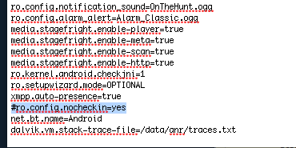
Test Setup
On the computer being used for testing
Step 11: Update the build.props and comment out the ro.config.nocheckin=yes line:
Notes:
Update the build.props to comment out the ro.config.nocheckin=yes line. This is needed later if we decide to install the Android Market for testing.

Slide 23
Test Setup
On the computer being used for testing
Step 12: Remount the system file for writing and push the files back onto the emulated device:
# Mike-Park:platform-tools mpark./adb remount
remount succeeded
Mike-Park:platform-tools mpark$ ./adb push cacerts.bks /etc/security/cacerts.bks
1946 KB/s (62140 bytes in 0.031s)
Mike-Park:platform-tools mpark$ ./adb push ./build.prop /system/build.prop
248 KB/s (1560 bytes in 0.006s)
Mike-Park:platform-tools mpark$
Notes:
Add the updated files to the new system.img file

Slide 24
Test Setup
On the computer being used for testing
Step 13: Remove the SDKSetup.apk file from the image:
Mike-Park:platform-tools mpark$ ./adb shell rm /system/app/SdkSetup.apk
Step 12b: Move the /system/sbin/su to su.bak:
./adb shell mv /system/xbin/su /system/xbin/su.bak
Notes:
Removing the SDKSetup.apk file allows changes to survive a restart of the image. Moving su to su.bak helps hide the fact that you are running on an emulator for those apps that try to detect rooted or emulator apps

Slide 25
Test Setup
On the computer being used for testing
Step 14: Shutdown the emulator, and delete the following :
userdata.img, userdata-qemu.img and cache.img
Restart and you are ready to go.
Notes:
Note that at this point, installing the Android Market is a simple as moving the .apks to the device.

Slide 26
Test Setup
Now What?
Select your target.
Reverse Engineering.
Proxy.
Hack.
Notes:
Talk about the foibles and pitfalls

Slide 27
Reversing Android Apps

Slide 28
Reversing Android
Android apps are written in Java
You can use your favorite IDE with a freely downloadable Android SDK plugin (for Eclipse, for instance)
Like (unobfuscated) Java apps, they can be easily reversed with the right tools
With Android, byteocde can even be altered and apps repackaged
Notes:
First step in Pen Testiing

Slide 29
Reversing Android
Reversing tools:
http://code.google.com/p/dex2jar/ Dex2Jar – converts dex (Dalvik bytecode) to a jar (java bytecode)
http://code.google.com/p/android4me/downloads/list AXMLPrinter2 - a tool for converting Android binary xml format to regular xml.
http://java.decompiler.free.fr/ JD – a GUI tool for decompiling Java bytecode back to java source (see above)
http://code.google.com/p/smali/ Smali and baksmali - assembler/disassembler for the dex format
Notes:
Discuss each tool and what the are used for.

Slide 30
Demo Reversing an Android App
See the demo
Notes:
Reverse an .apk with dex2jar and then decompile with JD-GUI

Slide 31
Reversing Android
Why Reverse?
Things to look for
Hardcoded credentials
Test credentials
Bad design
Bootstrap credentials
Understand the Code
Know how things flow
Find out what crypto is used
How does the app handle input or output
Notes:
A good first step is to reverse and examine the code for embedded credentials and embedded strings that can help you break encryption, login to a server or basically find out how the app works. Store sensistive data in files, SQLLite? Connect with a server? Etc
Helps find new targets.

Slide 32
Proxy and Hack

Slide 33
Proxy and Hack
Start up
Start your Burp proxy
Start your AVD, pointing it to the Burp proxy with the –http-proxy option:
./emulator -avd TestDevice -http-proxy http://127.0.0.1:8080 -partition-size 128
Test by going to https://mail.google.com. You may have to adjust Burp to get the right hostname.
Watch your gmail go through the Proxy.
Notes:
Start up and show the proxying

Slide 34
Proxy and Hack
Install the Target Application:
Use the adb to install the application
./adb install AppUnderTest.apk
Notes:
Install

Slide 35
Proxy and Hack
Show demo
Notes:
Show an apk communicating with a server via Burp. Show adjustments to hostname if needed.

Slide 36
Tips and Tricks

Slide 37
Tips and Tricks
Tip 1: Dumping memory
Its possible to dump the memory of a running Android App and then pull that off the device for examination
./adb shell
# chmod 777 /data/misc <- place where the heap dump will go
# ps <- get the pid of the app you wish to dump
# kill -10 {pid} <- dumps the process memory to /data/misc in a format like heap-dump-tm1310992312-pid267.hprof
Notes:
Quick demo….show a screenshot if needed

Slide 38
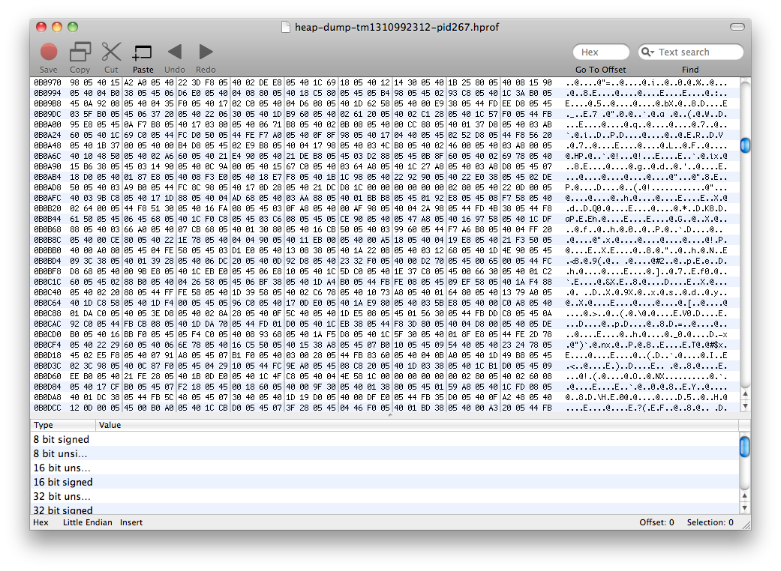
Tips and Tricks
Tip 1 (cont): Dumping memory
Exit the shell and issue:
Mike-Park:platform-tools mpark$ ./adb pull /data/misc/heap-dump-tm1310992312-pid267.hprof.
Open up in your favourite hex editor
Notes:
Quick demo….show a screenshot if needed

Slide 39
Tips and Tricks
Tip 2: Firing Activities and Intents
Its possible force parts of an application to fire without interacting directly with the UI
# cd /data/misc <- change to a writable directory
# dumpsys package > pkg.txt <- dump the list of packages
Look in the file and launch a selected intent of the target app directly:
# am start -n {full path to intent}
This can be used to decrypt files or query SQLLite even if the app is locked.
Notes:
Talk about using this to decrypt SQLLite db and files on the filesystem Qucik demo if there is time

Slide 40
Solutions?

Slide 41
Issues with Android
Code is easily reversible, as we have demonstrated
Devices are open, so easily “rooted” or changed
Underlying OS is susceptible to various vulns and exploits similar to desktops in years past
Mobile is hot – developers are under pressure to deliver and deliver fast.
Developers use cut-and-paste sample code
Don’t always appreciate the underlying frameworks or OS
Configs can go wrong – making an intent public instead of private, for instance
Occasionally, bad design.
Lots of easily available tools
Open platform + restrictive vendors = Trouble waiting to happen.
Notes:
Give a few well known examples of each – finding test usernames and passwords embedded in code, db passwords embedded in static PRAGMA hexkeys value etc
Mention the desire comes from vendors trying to restrict user’s use of devices leads to users breaking and hacking their devices.
List the tools and mention the 2600 article

Slide 42
Possible Solutions
Developer Training – better coding standards, secure coding training and better framework training
Add security testing and code review to the development lifecycle
Use Obfuscation to inhibit reverse engineering
Additional Frameworks – use third-party libraries to enhance security
WAF on the server\web side
Custom secure loaders
Strong encryption of sqllite and application files
Customized OS – if you can control the whole device, consider customizing the OS (its Open Source, after all)
Remove all unneeded libs
Harden
Custom certs etc
Notes:
Defense in depth – try to do a bit of all 3.
Devs – assume your code will be reversed and the app will operate in the hands of the bad guy

Slide 43
Conclusions

Slide 44
Conclusion & Summary
Mobile applications and related security breaches receive a lot of media attention
Android app security testing requires specialized techniques, lots of steps, but each step is easy
Most Android app vulnerabilities are similar to vulnerabilities seen on other platforms, and can be mitigated with careful development and additional libs

